Slide 1

Lecture 2 Relational Model (Chapter 2)
Jihong Guan
Email: jhguan@tongji.edu.cn
Department of Computer Science and Technology
Tongji University

Slide 2
Outline of the Course
Part 0: Overview
Ch1: Introduction
☞ Part 1 Relational Databases
Ch2: Relational model (data model, relational algebra)
Ch3&4: SQL(Structured Query Language)
Ch5: Advanced SQL
Part 2 Database Design
Ch6: Database design based on E-R model
Ch7: Relational database design
Part 3 Application Design & Development
Ch8: Complex data types
Ch9: Application development
Part 4 Big data analytics
Ch10: Big data
Ch11: Data analytics
Part 5 Data Storage & Indexing
Ch12: Physical storage system
Ch13: Data storage structure
Ch14: Indexing
Part 6 Query Processing & Optimization
Ch15: Query processing
Ch16: Query optimization
Part 7 Transaction Management
Ch17: Transactions
Ch18: Concurrency control
Ch19: Recovery system
Part 8 Parallel & Distributed Database
Ch20: Database system architecture
Ch21-23: Parallel & distributed storage, query processing & transaction processing
Part 9
DB Platform:OceanBase, MongoDB, Neo4J

Slide 3
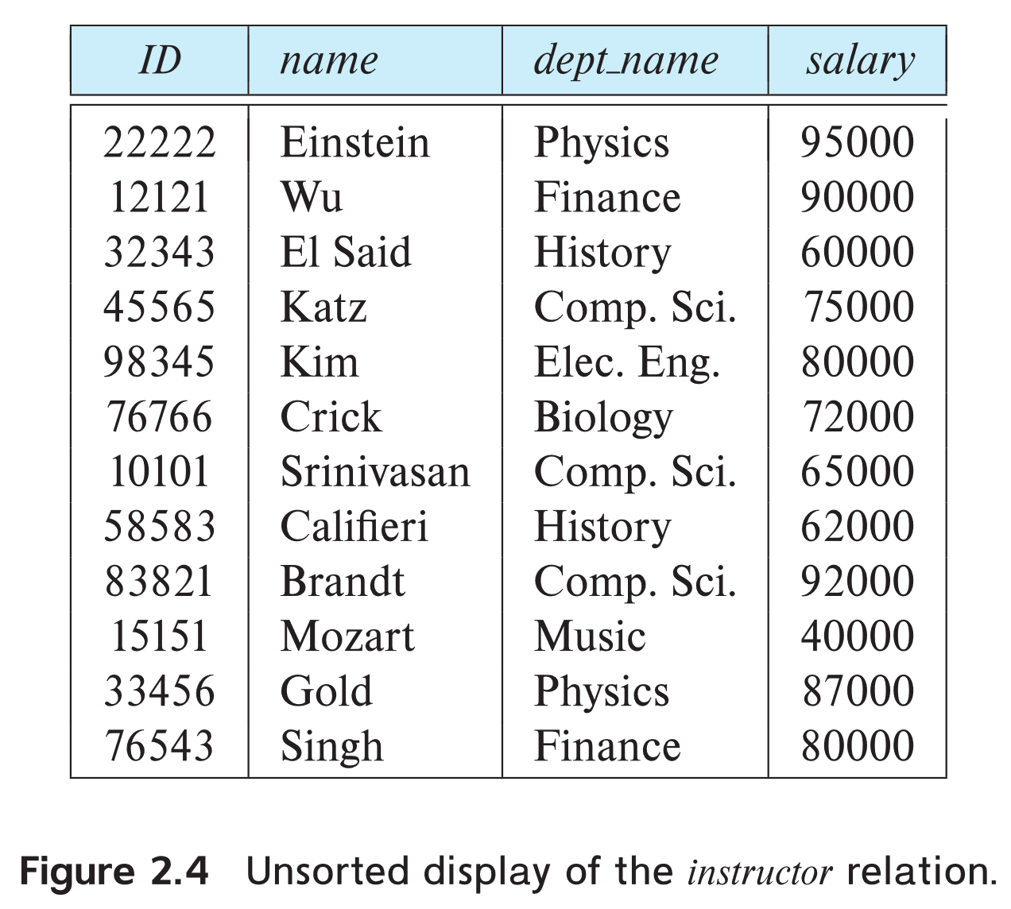
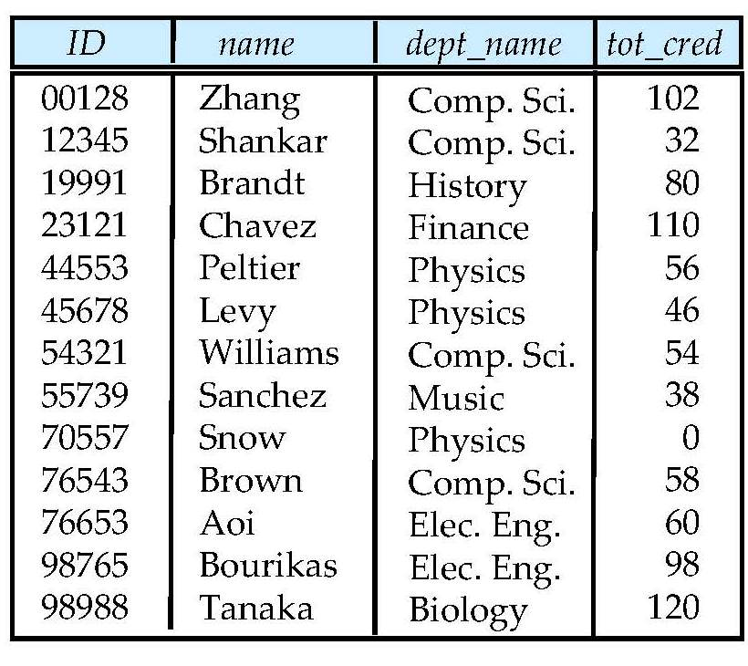
University Database
Instructor table
Student table

Slide 4
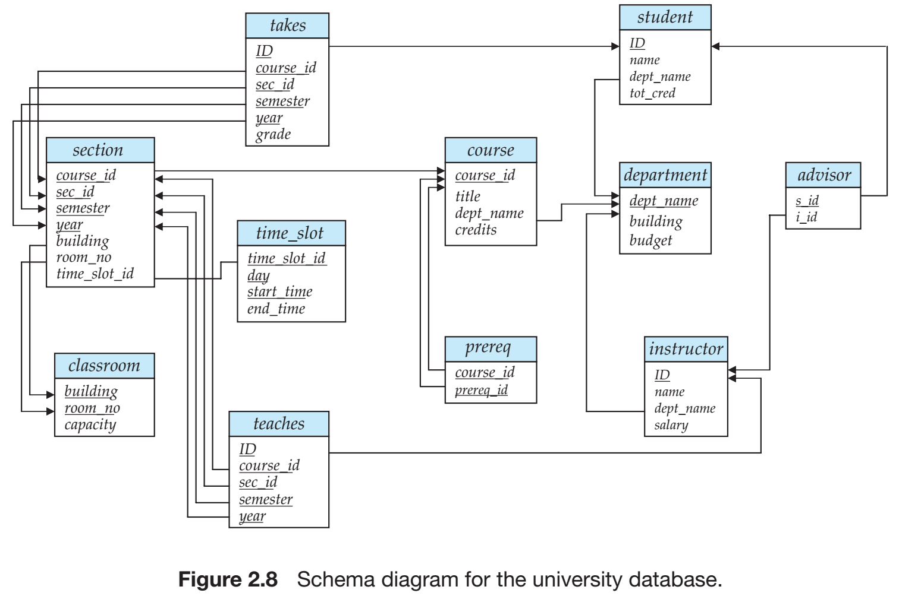
University Database
Relational Model
SQL
Database Design
Storage & Query
Transactions

Slide 5
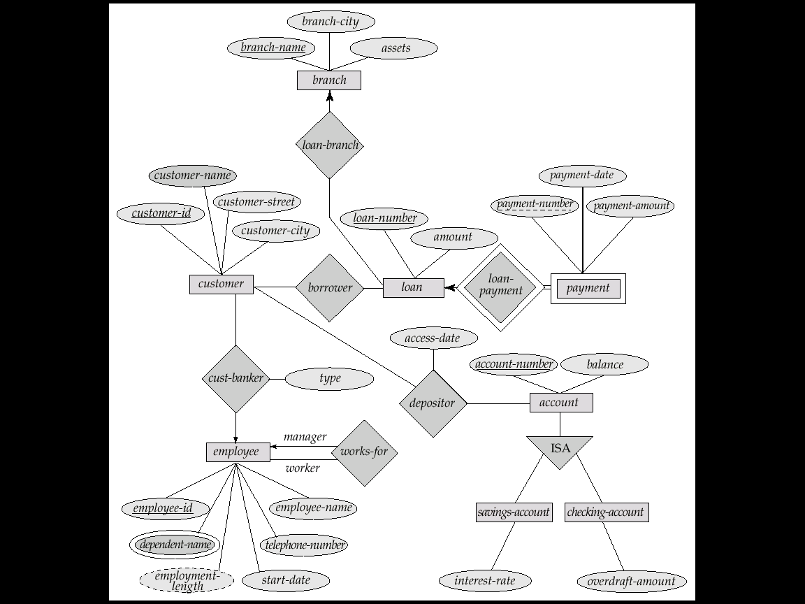
E-R Diagram for a Banking Enterprise
account-branch
Weak entity sets
multi-valued attribute
derived attribute

Slide 6
The Banking Schema
branch = (branch_name, branch_city, assets)
customer = (customer_id, customer_name, customer_street, customer_city)
loan = (loan_number, amount)
account = (account_number, balance)
employee = (employee_id, employee_name, telephone_number, start_date)
dependent_name = (employee_id, dname) (derived from a multivalued attribute)
account_branch = (account_number, branch_name)
loan_branch = (loan_number, branch_name)
borrower = (customer_id, loan_number)
depositor = (customer_id, account_number, access_date)
cust_banker = (customer_id, employee_id, type)
works_for = (worker_employee_id, manager_employee_id)
payment =(loan_number,payment_number,payment_date,payment_amount)
savings_account = (account_number, interest_rate)
checking_account = (account_number, overdraft_amount)

Slide 7
Outline
☞ Structure of Relational Database
Database Schema
Keys
Schema Diagrams
Relational Query Languages
Relational Algebra

Slide 8
Structure of Relational Database
Example of a Relation/Table

Slide 9
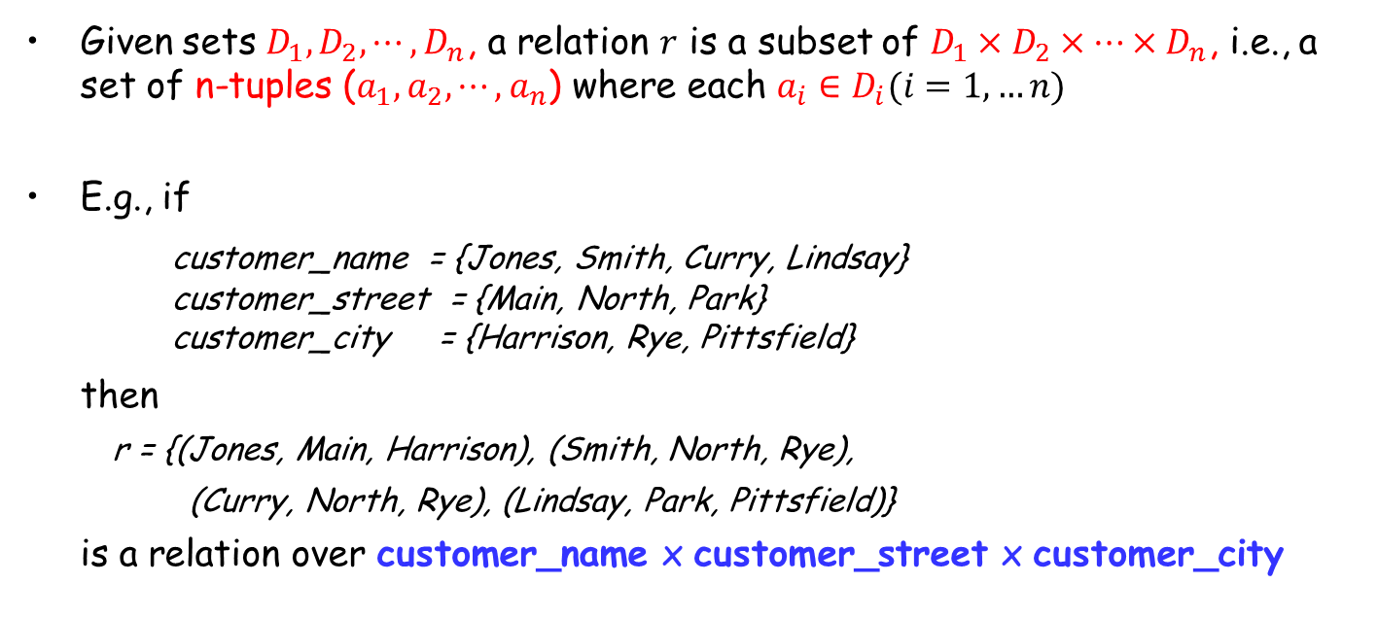
Basic Structure of a Relation
Given sets $D_{1},D_{2},⋯,D_{n}$, a relation $r$ is a subset of $D_{1}×D_{2}×⋯×D_{n}$, i.e., a set of n-tuples ($a_{1},a_{2},⋯,a_{n}$) where each $a_{i}∈D_{i}(i=1,…n)$
E.g., if
customer_name = {Jones, Smith, Curry, Lindsay} customer_street = {Main, North, Park} customer_city = {Harrison, Rye, Pittsfield}
then
r = {(Jones, Main, Harrison), (Smith, North, Rye),
(Curry, North, Rye), (Lindsay, Park, Pittsfield)}
is a relation over customer_name x customer_street x customer_city
n-tuples: n元组

Slide 10
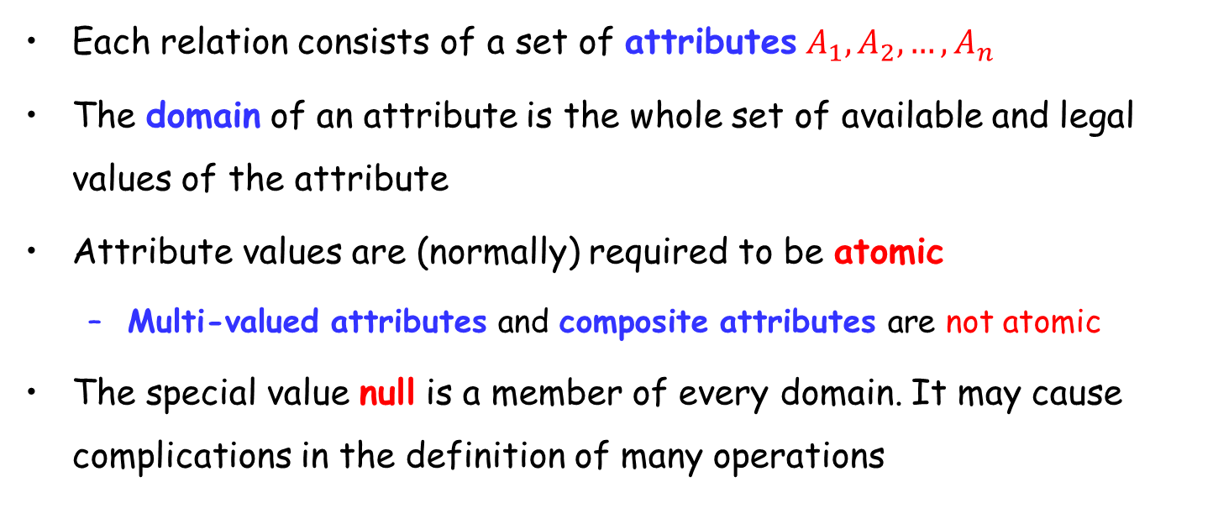
Attribute(属性)
Each relation consists of a set of attributes $A_{1},A_{2},…,A_{n}$
The domain of an attribute is the whole set of available and legal values of the attribute
Attribute values are (normally) required to be atomic
Multi-valued attributes and composite attributes are not atomic
The special value null is a member of every domain. It may cause complications in the definition of many operations

Slide 11
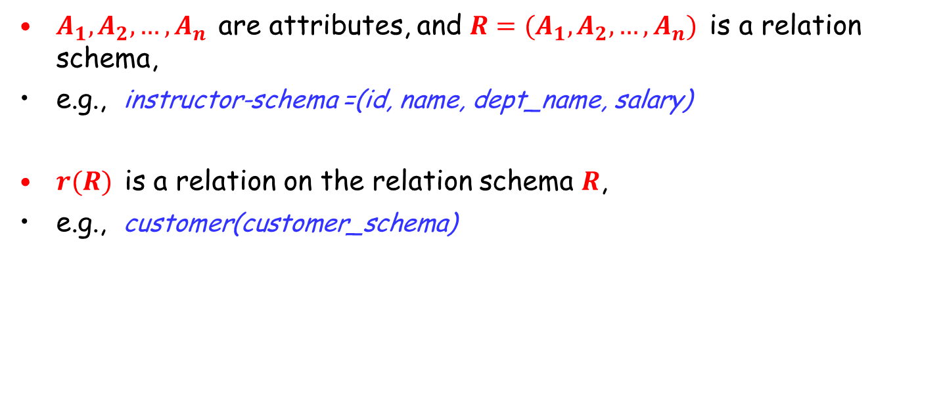
Relation Schema (关系模式)
$A_{1},A_{2},…,A_{n}$ are attributes, and $R=(A_{1},A_{2},…,A_{n})$ is a relation schema,
e.g., instructor-schema =(id, name, dept_name, salary)
$r(R)$ is a relation on the relation schema $R$,
e.g., customer(customer_schema)

Slide 12
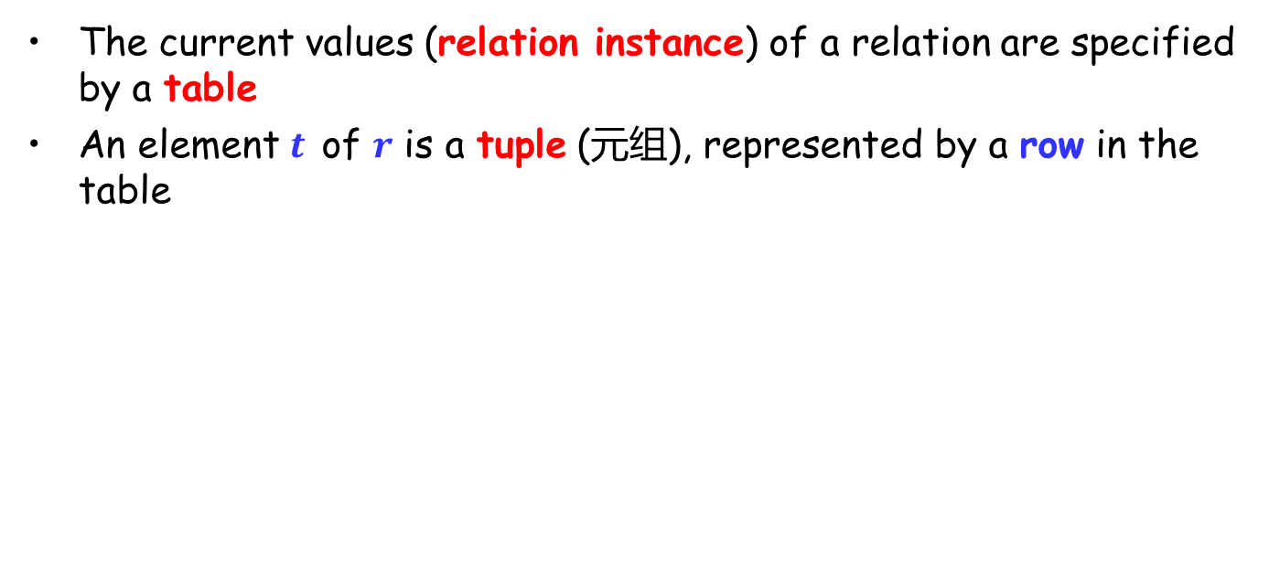
Relation Instance (关系实例)
The current values (relation instance) of a relation are specified by a table
An element $t$ of $r$ is a tuple (元组), represented by a row in the table
Attributes/Columns
Tuples/Rows

Slide 13
Relations are Unordered
The order of tuples/attributes in a relation is irrelevant. Tuples could be stored in an arbitrary order
E.g., instructor relation with unordered tuples

Slide 14
Outline
Structure of Relational Database
☞ Database Schema
Keys
Schema Diagrams
Relational Query Languages
Relational Algebra

Slide 15
Database Schema
A database consists of multiple relations
Storing all information as a single relation results in
repetition of information, e.g., one department has many students, record the information of both department and student
the need for null values, e.g., represent a customer without an account
Normalization(规范化) theory (Chapter 7) deals with how to design relational schemas

Slide 16
Instructor relation
E-R Diagram for University Database

Slide 17
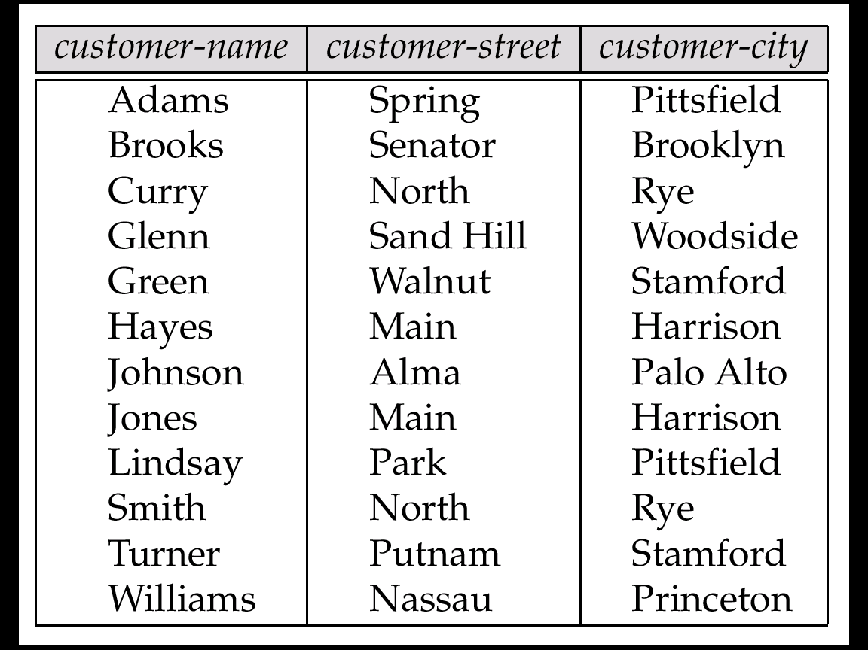
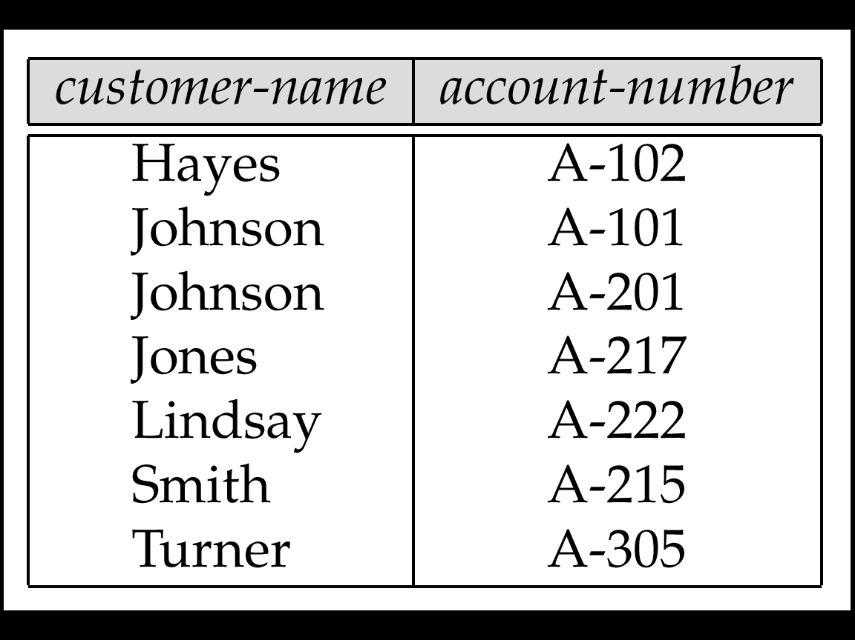
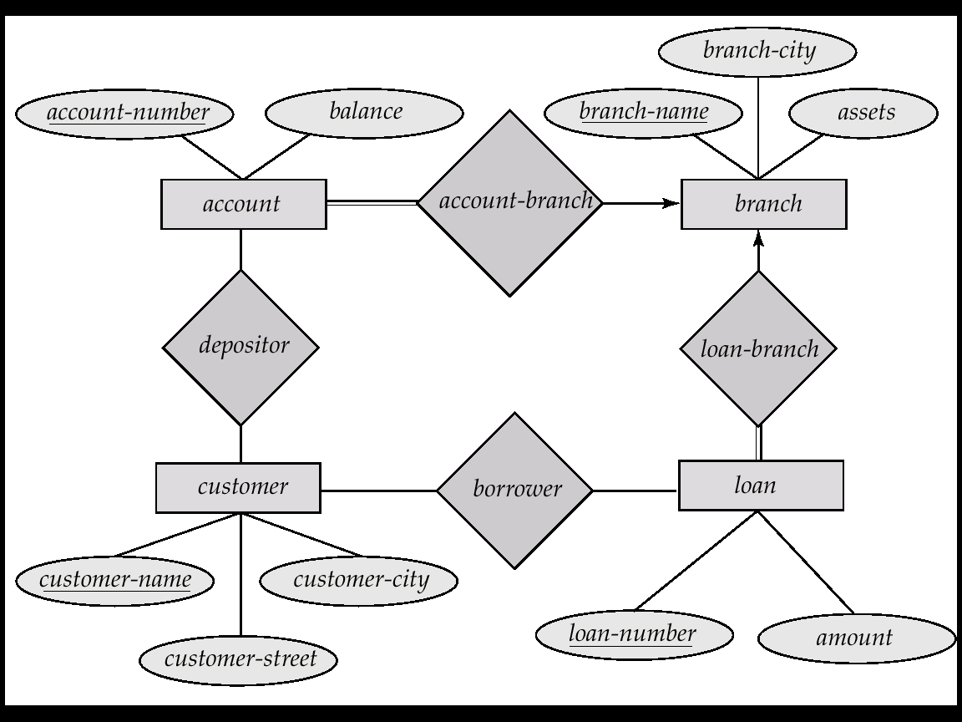
The customer Relation
The depositor Relation
E-R Diagram for the Banking Enterprise

Slide 18
Outline
Structure of Relational Database
Database Schema
☞ Keys
Schema Diagrams
Relational Query Languages
Relational Algebra

Slide 19
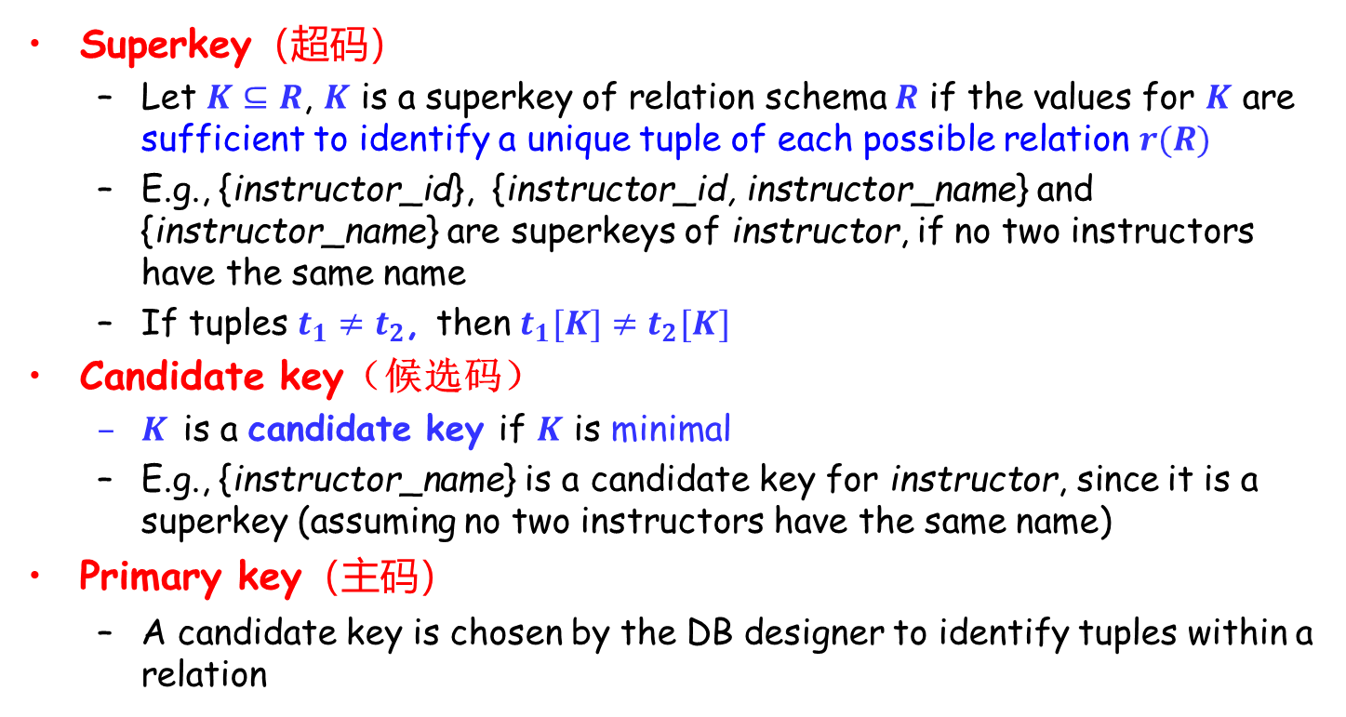
Keys (码、键)
Superkey（超码）
Let $K⊆R$, $K$ is a superkey of relation schema $R$ if the values for $K$ are sufficient to identify a unique tuple of each possible relation $r(R)$
E.g., {instructor_id}, {instructor_id, instructor_name} and {instructor_name} are superkeys of instructor, if no two instructors have the same name
If tuples $t_{1}≠t_{2}$, then $t_{1}[K]≠t_{2}[K]$
Candidate key（候选码）
$K$ is a candidate key if $K$ is minimal
E.g., {instructor_name} is a candidate key for instructor, since it is a superkey (assuming no two instructors have the same name)
Primary key（主码）
A candidate key is chosen by the DB designer to identify tuples within a relation

Slide 20
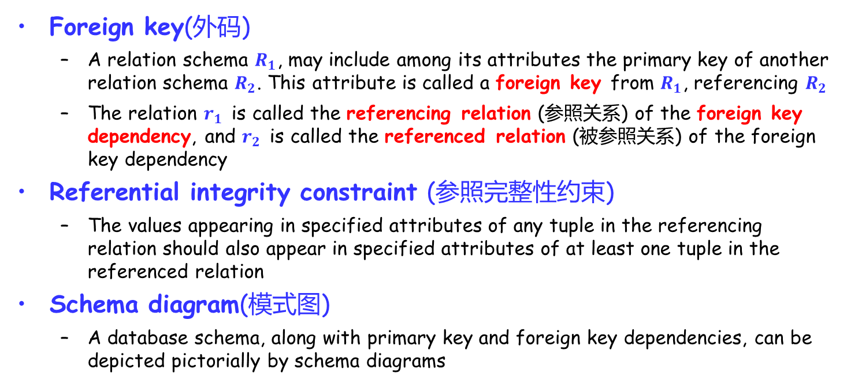
Keys (Cont.)
Foreign key(外码)
A relation schema $R_{1}$, may include among its attributes the primary key of another relation schema $R_{2}$. This attribute is called a foreign key from $R_{1}$, referencing $R_{2}$
The relation $r_{1}$ is called the referencing relation (参照关系) of the foreign key dependency, and $r_{2}$ is called the referenced relation (被参照关系) of the foreign key dependency
Referential integrity constraint (参照完整性约束)
The values appearing in specified attributes of any tuple in the referencing relation should also appear in specified attributes of at least one tuple in the referenced relation
Schema diagram(模式图)
A database schema, along with primary key and foreign key dependencies, can be depicted pictorially by schema diagrams

Slide 21
Outline
Structure of Relational Database
Database Schema
Keys
☞ Schema Diagrams
Relational Query Languages
Relational Algebra

Slide 22
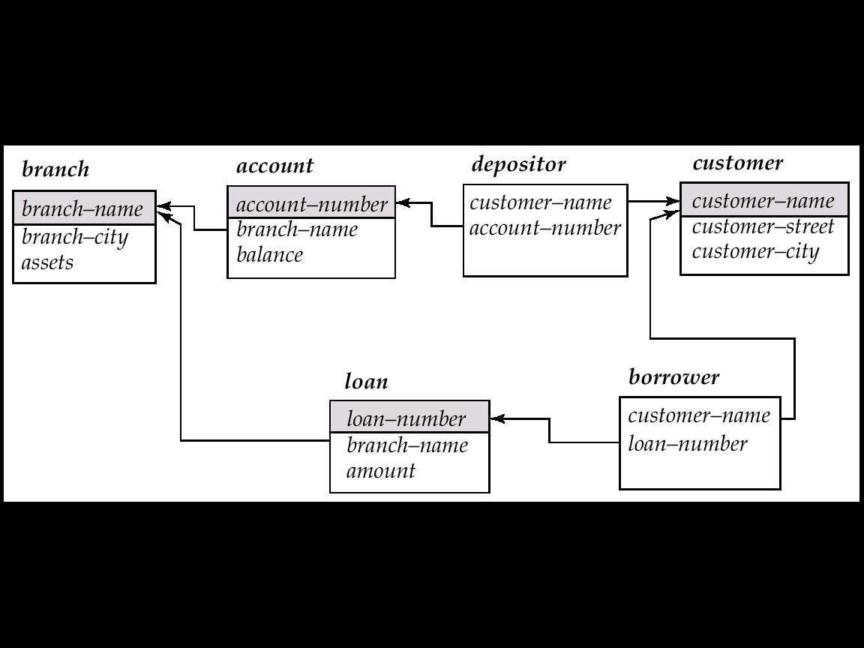
Schema Diagrams
branch (branch_name, branch_city, assets)
customer (customer_name, customer_street, customer_city)
account (account_number, branch_name, balance)
loan (loan_number, branch_name, amount)
depositor (customer_name, account_number)
borrower (customer_name, loan_number)
Banking database
Schema Diagram (模式图) for the banking enterprise

Slide 23
Schema diagram for the university database
Notes:
Referential integrity constraints other than foreign key constraints are not shown explicitly in schema diagrams. We will study a different diagrammatic representation called the entity-relationship diagram later, in Chapter 7. Entityrelationship diagrams let us represent several kinds of constraints, including general referential integrity constraints.

Slide 24
Determining Keys from E-R Sets
Strong entity set: has a primary key
Weak entity set: may not have sufficient attributes to form a primary key
Discriminator (分辨符) plus the Key of the identifying entity set (标识实体集, or owner entity set 属主实体集)
Relationship set
Union of keys of the related entity sets
(later discussed in Chapter 6)

Slide 25
Outline
Structure of Relational Database
Database Schema
Keys
Schema Diagrams
☞ Relational Query Languages
Relational Algebra

Slide 26
Relational Query Languages
Languages used to request information from the database
Categories of languages
Procedural
Relational Algebra（关系代数）
Non-procedural
SQL（结构化查询语言）
Tuple Relational Calculus（元组关系演算）
R-S＝{t│R(t)∧┐S（t）}，R∪S={t│R(t)∨S(t)}
Domain Relational Calculus（域关系演算）
{<A, B, C> | <A, B, C> ∈ Student ∧ A = “Monitor" }

Slide 27
Outline
Structure of Relational Database
Database Schema
Keys
Schema Diagrams
Relational Query Languages
☞ Relational Algebra

Slide 28
Relational Algebra
A procedural language consisting of a set of operations that take one or two relations as input and produce a new relation as the result
Six basic operations
Select (选择)
Project (投影)
Union (集合并)
Set difference (集合差)
Cartesian product (笛卡尔积)
Rename (重命名)

Slide 29

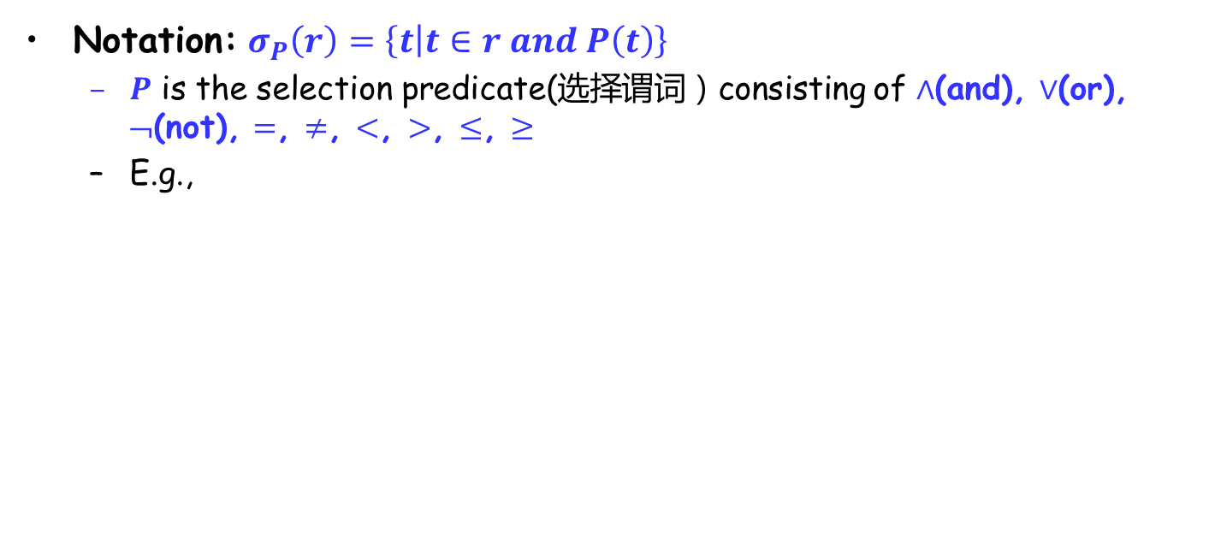
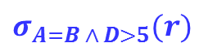
Select Operation
Notation: $σ_{P}\left(r\right)=\left\{t | t∈r and P\left(t\right)\right\}$
$P$ is the selection predicate(选择谓词）consisting of $∧$(and), $∨$(or), ¬(not), $=$, $≠$, $<$, $>$, $≤$, $≥$
E.g.,
A
B
C
D
A
B
C
D
α
α
β
β
α
β
β
β
1
5
12
23
7
7
3
10
α
β
α
β
1
23
7
10
relation $r$
$$σ_{A=B ∧ D>5}(r)$$

Slide 30
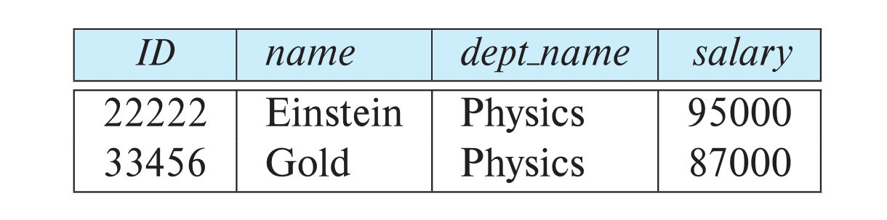
Select Operation (Cont.)
E.g., select those tuples of the instructor relation where the instructor is in the “Physics” department
Query
σ _{dept_name=“Physics”} (instructor)
Result
Instructor relation

Slide 31
Select Operation (Cont.)
Allow comparisons using =, ≠, >, ≥, <, ≤ in the selection predicate.
Can combine several predicates into a larger predicate by using the connectives: ∧ (and), ∨ (or), ¬ (not)
Example: Find the instructors in Physics with a salary greater $90,000
σ _{dept_name=“Physics”} ∧ _{salary >} _{90,000} (instructor)
The select predicate may include comparisons between two attributes.
Example: find all departments whose name is the same as their building name:
σ _{dept_name = building} (department)

Slide 32

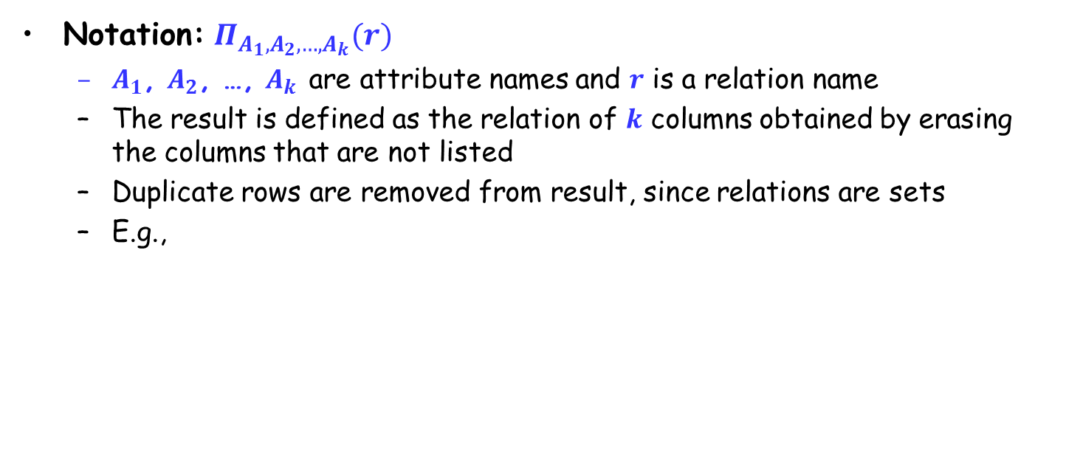

Project Operation
Notation: $Π_{A_{1},A_{2},…,A_{k}}(r)$
$A_{1}$, $A_{2}$, …, $A_{k}$ are attribute names and $r$ is a relation name
The result is defined as the relation of $k$ columns obtained by erasing the columns that are not listed
Duplicate rows are removed from result, since relations are sets
E.g.,
A
B
C
A
C
A
C
α
α
β
β
10
20
30
40
1
1
1
2
α
α
β
β
1
1
1
2
α
β
β
1
1
2
=
relation $r$
$$Π_{A,C}(r)$$

Slide 33
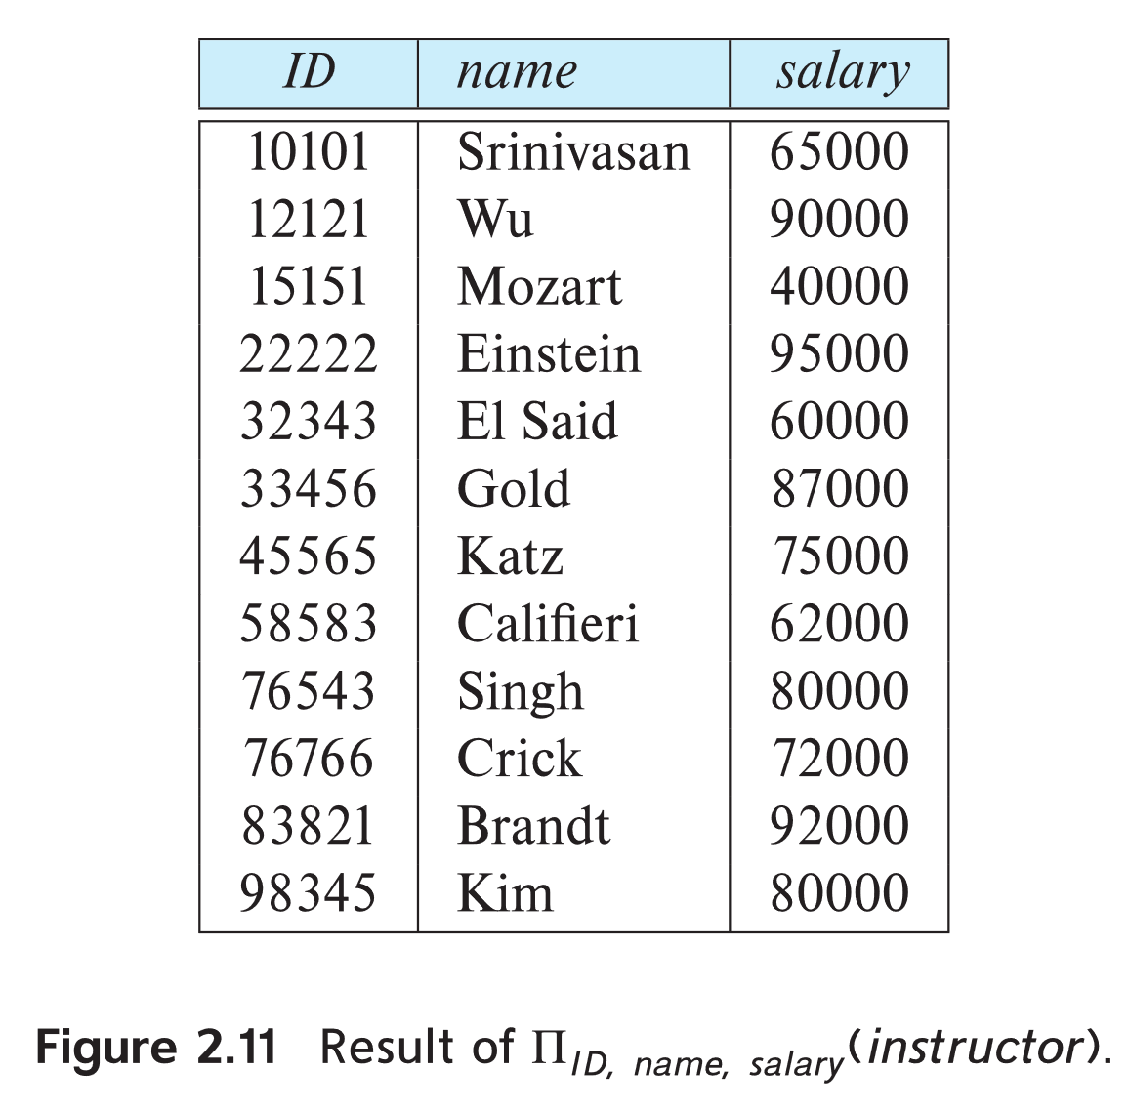
Project Operation (Cont.)
E.g., eliminate the dept_name attribute of instructor
Query: ∏_{ID, name, salary} (instructor)
Result:
Instructor relation

Slide 34

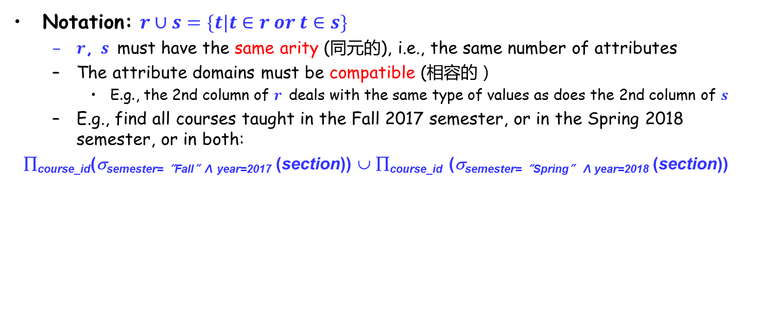

Union Operation
Notation: $r∪s=\{t|t∈r or t∈s\}$
$r$, $s$ must have the same arity (同元的), i.e., the same number of attributes
The attribute domains must be compatible (相容的）
E.g., the 2nd column of $r$ deals with the same type of values as does the 2nd column of $s$
E.g., find all courses taught in the Fall 2017 semester, or in the Spring 2018 semester, or in both:
∏_{course_id}(σ_{semester=“Fall”Λ year=2017} (section)) ∪ ∏_{course_id} (σ_{semester=“Spring” Λ year=2018} (section))
A
B
A
B
A
B
α
α
β
1
2
1
α
β
2
3
α
α
β
β
1
2
1
3
$$r∪s$$
s
r
relations $r$, $s$

Slide 35
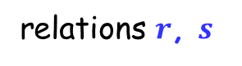
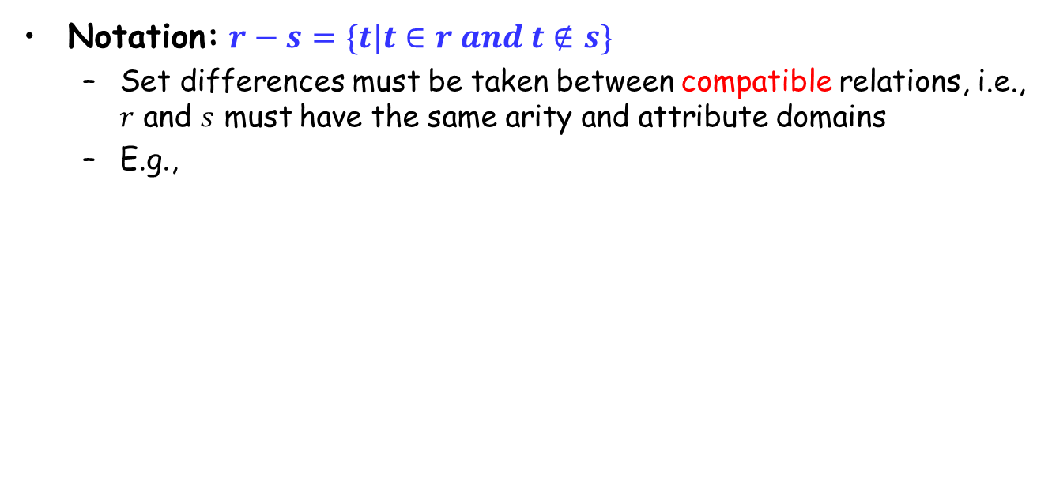

Set Difference Operation
Notation: $r−s=\{t|t∈r and t∉s\}$
Set differences must be taken between compatible relations, i.e., $r$ and $s$ must have the same arity and attribute domains
E.g.,
A
B
A
B
A
B
α
α
β
1
2
1
α
β
2
3
α
β
1
1
s
r
relations $r$, $s$
$$r−s$$

Slide 36
Set Difference Operation (Cont.)
E.g., to find all courses taught in the Fall 2017 semester, but not in the Spring 2018 semester
∏_{course_id}(σ_{semester=“Fall”Λ year=2017} (section)) −
∏_{course_id} (σ_{semester=“Spring”Λ year=2018} (section))

Slide 37
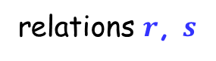
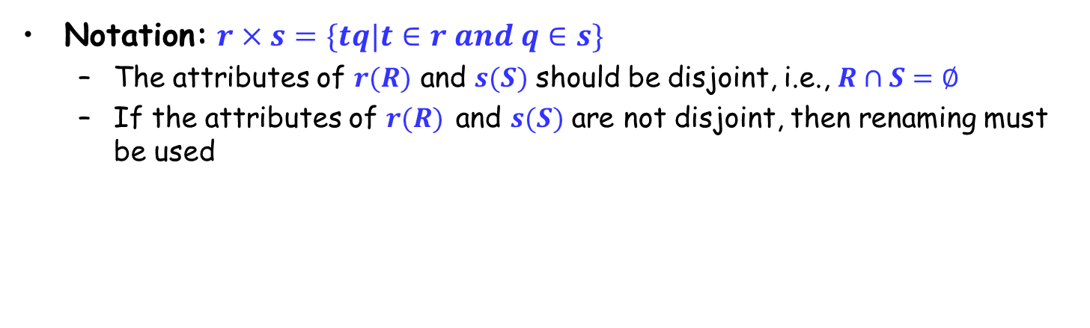

Cartesian Product Operation
Notation: $r×s=\{tq|t∈r and q∈s\}$
The attributes of $r(R)$ and $s(S)$ should be disjoint, i.e., $R∩S=∅$
If the attributes of $r(R)$ and $s(S)$ are not disjoint, then renaming must be used
A
B
C
D
E
A
B
C
D
E
α
α
α
α
β
β
β
β
1
1
1
1
2
2
2
2
α
β
β
γ
α
β
β
γ
10
10
20
10
10
10
20
10
a
a
b
b
a
a
b
b
α
β
1
2
α
β
β
γ
10
10
20
10
a
a
b
b
r
s
relations $r$, $s$
$$r×s$$

Slide 38
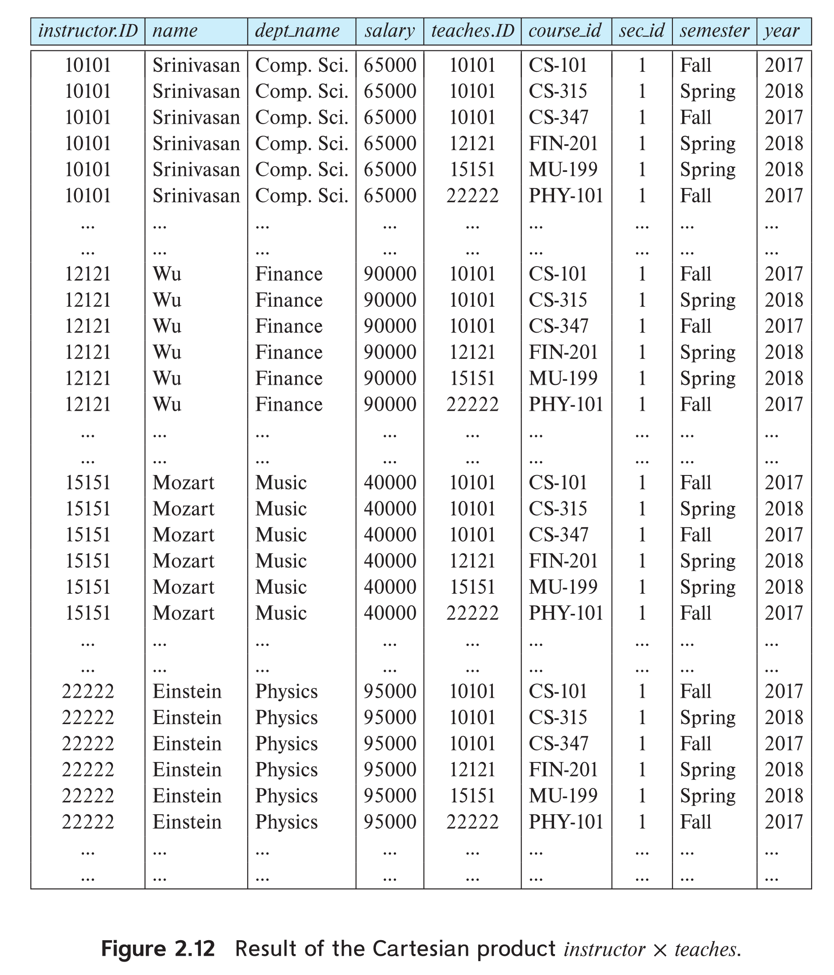
instructor X teaches table

Slide 39
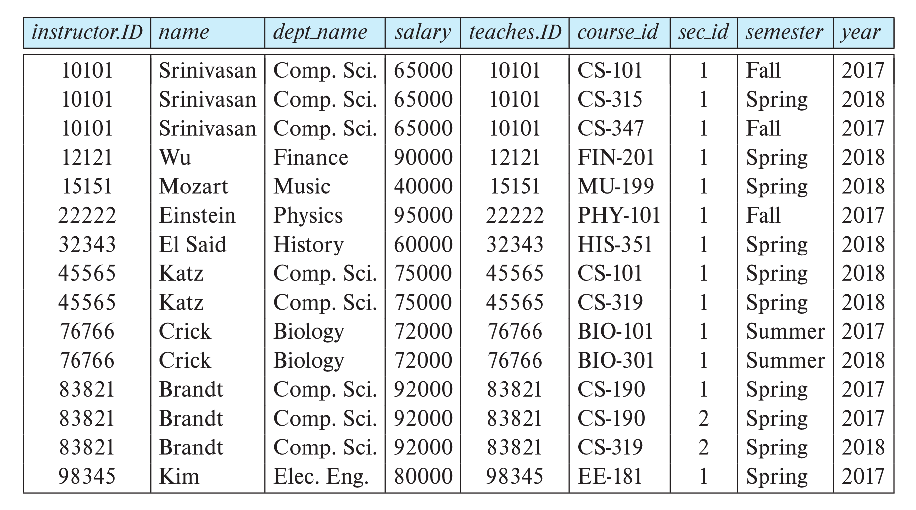
Cartesian Product Operation (Cont.)
σ_{instructor.id = teaches.id} (instructor x teaches))

Slide 40

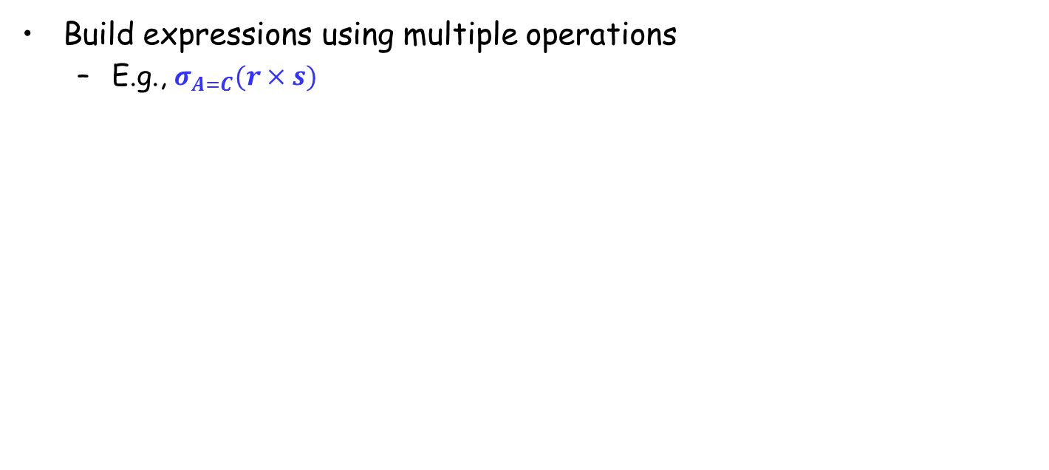
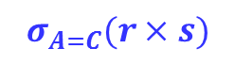
Composition of Operations
Build expressions using multiple operations
E.g., $σ_{A=C}(r×s)$
A
B
C
D
E
α
α
α
α
β
β
β
β
1
1
1
1
2
2
2
2
α
β
β
γ α
β
β
γ
10
10
20
10
10
10
20
10
a
a
b
b
a
a
b
b
A
B
C
D
E
α
β
β
1
2
2
α
β
β
10
20
20
a
a
b
$$σ_{A=C}(r×s)$$
$$r×s$$

Slide 41
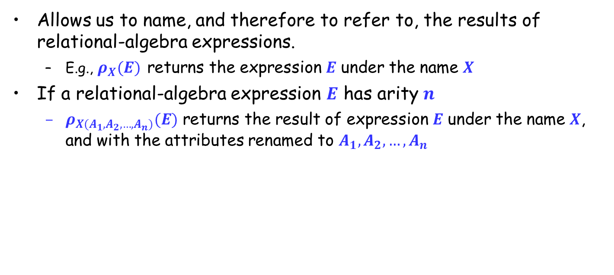
Rename Operation (更名运算)
Allows us to name, and therefore to refer to, the results of relational-algebra expressions.
E.g., $ρ_{X}(E)$ returns the expression $E$ under the name $X$
If a relational-algebra expression $E$ has arity $n$
$ρ_{X(A_{1}, A_{2}, …, A_{n})}(E)$ returns the result of expression $E$ under the name $X$, and with the attributes renamed to $A_{1}, A_{2},…,A_{n}$

Slide 42
Notes about Relational Languages
Each query input is a table (or a set of tables)
Each query output is a table.
All data in the output table appears in one of the input tables

Slide 43
Schema for Following Examples
branch (branch_name, branch_city, assets)
customer (customer_name, customer_street, customer_city)
account (account_number, branch_name, balance)
loan (loan_number, branch_name, amount)
depositor (customer_name, account_number)
borrower (customer_name, loan_number)

Slide 44


Example Queries (1)
Find all loans of over $1200
Find the loan number for each loan of an amount greater than $1200
$$σ_{amount>1200}(loan)$$
$$Π_{loan_number}(σ_{amount>1200}(loan))$$

Slide 45
Example Queries (2)
Find the names of all customers who have a loan, an account, or both, from the bank
$$Π_{customer_name}\left(borrower\right){ ∪Π}_{customer_name}\left(depositor\right)$$

Slide 46
Example Queries (3)
Find the names of all customers who have a loan at the Perryridge branch
Find the names of all customers who have a loan at the Perryridge branch but do not have an account at any branch of the bank
∏_{customer_name} (σ_{branch_name=“Perryridge”}
(σborrower.loan_number = loan.loan_number(borrower x loan)))
∏_{customer_name} (σ_{branch_name = “Perryridge”}
(σborrower.loan_number = loan.loan_number(borrower x loan))) – ∏_{customer_name}(depositor)

Slide 47
Example Queries (4)
Find the names of all customers who have a loan at the Perryridge branch
Query 1
Query 2
∏_{customer_name}(σ_{branch_name = “Perryridge”} ( σborrower.loan_number = loan.loan_number(borrower x loan)))
∏_{customer_name}(σloan.loan_number = borrower.loan_number ((σ_{branch_name = “Perryridge”}(loan)) x borrower))

Slide 48
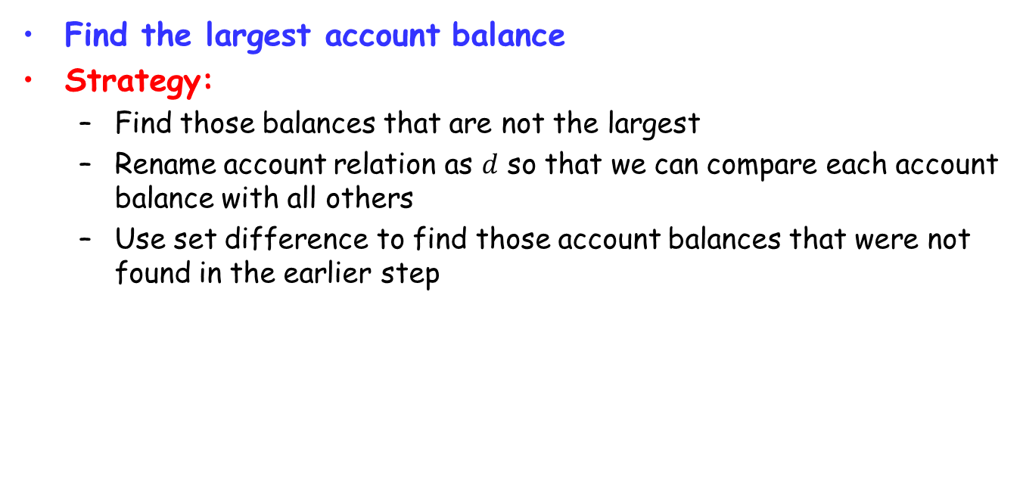
Example Queries (5)
Find the largest account balance
Strategy:
Find those balances that are not the largest
Rename account relation as $d$ so that we can compare each account balance with all others
Use set difference to find those account balances that were not found in the earlier step
∏_{balance}(account)
- ∏_{account.balance}
(σ_{account.balance < d.balance} (account x ρ_{d} (account)))

Slide 49
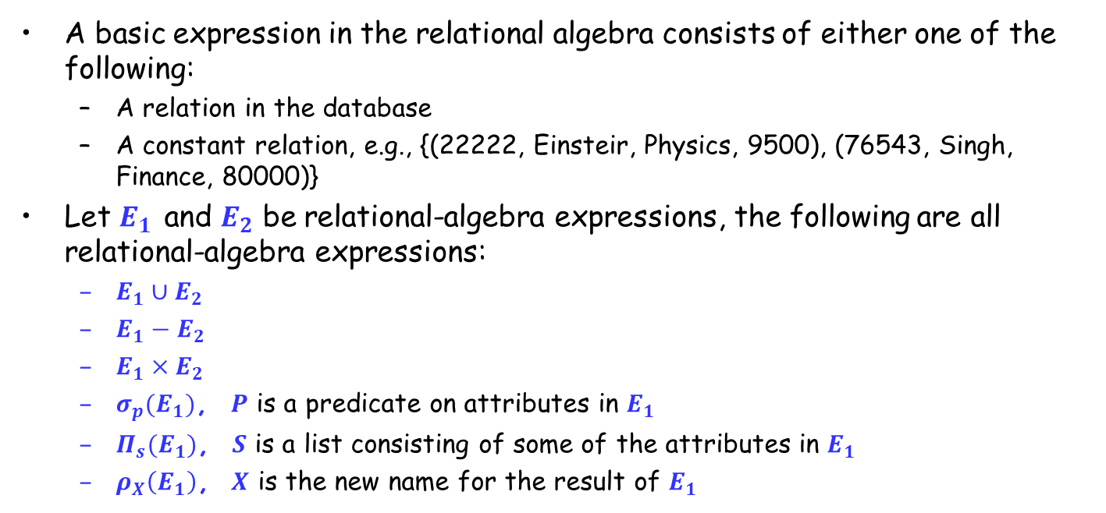
Relational Expressions
A basic expression in the relational algebra consists of either one of the following:
A relation in the database
A constant relation, e.g., {(22222, Einsteir, Physics, 9500), (76543, Singh, Finance, 80000)}
Let $E_{1}$ and $E_{2}$ be relational-algebra expressions, the following are all relational-algebra expressions:
$E_{1}∪E_{2}$
$E_{1}−E_{2}$
$E_{1}×E_{2}$
$σ_{p}(E_{1})$, $P$ is a predicate on attributes in $E_{1}$
$Π_{s}(E_{1})$, $S$ is a list consisting of some of the attributes in $E_{1}$
$ρ_{X}\left(E_{1}\right)$, $X$ is the new name for the result of $E_{1}$

Slide 50
Additional Operations
Additional operations
Set intersection (集合交)
Natural join (自然连接)
Outer join（外连接）
Division (除)
Assignment (赋值)
Additional operations do not add any power to the relational algebra, but simplify common queries

Slide 51
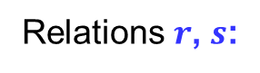
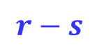
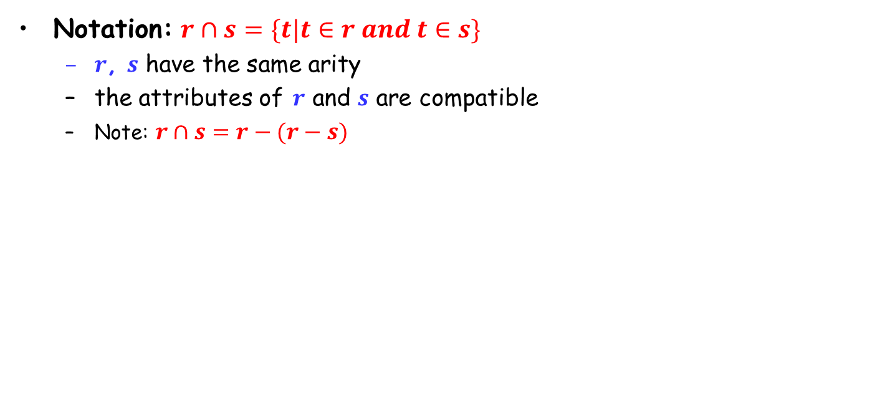
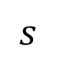
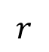

Set Intersection Operation
Notation: $r∩s=\{t|t∈r and t∈s\}$
$r$, $s$ have the same arity
the attributes of $r$ and $s$ are compatible
Note: $r∩s=r−(r−s)$
$$r$$
$$s$$
$$r−s$$
Relations $r$, $s$:
A B
A B
α
α
β
1
2
1
α
β
2
3
s
r
$r∩s$:
A B
α 2

Slide 52
Set Intersection Operation (Cont.)
E.g., Find the set of all courses taught in both the Fall 2017 and the Spring 2018 semesters.
∏_{course_id} (σ _{semester=“Fall” Λ year=2017} (section)) ∩
∏_{course_id} (σ _{semester=“Spring” Λ year=2018} (section))

Slide 53
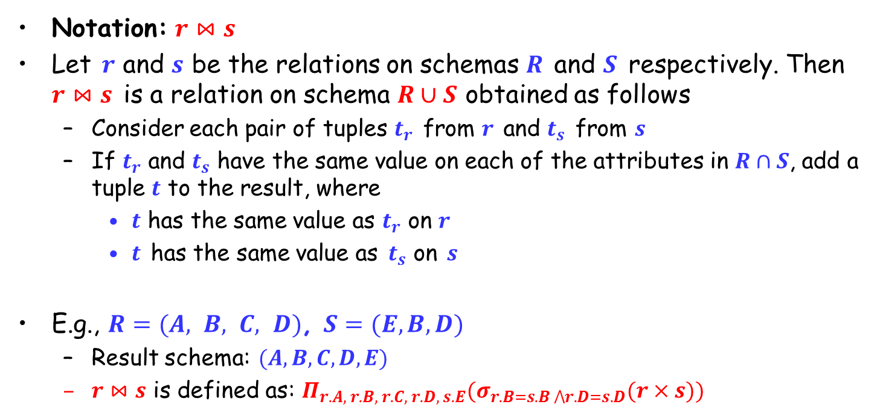
Natural Join Operation
Notation: $r⋈s$
Let $r$ and $s$ be the relations on schemas $R$ and $S$ respectively. Then $r⋈s$ is a relation on schema $R∪S$ obtained as follows
Consider each pair of tuples $t_{r}$ from $r$ and $t_{s}$ from $s$
If $t_{r}$ and $t_{s}$ have the same value on each of the attributes in $R∩S$, add a tuple $t$ to the result, where
$t$ has the same value as $t_{r}$ on $r$
$t$ has the same value as $t_{s}$ on $s$
E.g., $R=(A, B, C, D)$, $S=(E,B,D)$
Result schema: $(A,B,C,D,E)$
$r⋈s$ is defined as: $Π_{r.A, r.B, r.C, r.D, s.E}(σ_{r.B=s.B ⋀r.D=s.D}(r×s))$

Slide 54


Natural Join Operation – Example
A
B
C
D
B
D
E
α
β
γ
α
δ
1
2
4
1
2
α
γ
β
γ
β
a
a
b
a
b
1
3
1
2
3
a
a
a
b
b
α
β
γ
δ
∈
Relations $r$, $s$:
r
s
A
B
C
D
E
α
α
α
α
δ
1
1
1
1
2
α
α
γ
γ
β
a
a
a
a
b
α
γ
α
γ
δ
$r⋈s$:

Slide 55
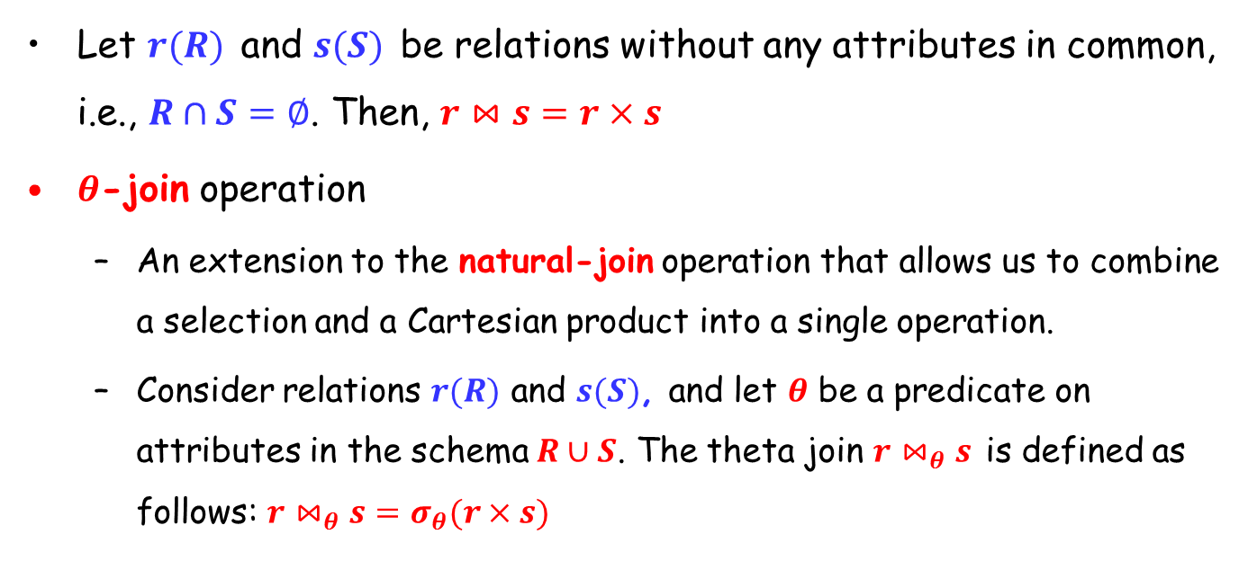
Natural Join Operation(cont.)
Let $r(R)$ and $s(S)$ be relations without any attributes in common, i.e., $R∩S=∅$. Then, $r⋈s=r×s$
$θ$-join operation
An extension to the natural-join operation that allows us to combine a selection and a Cartesian product into a single operation.
Consider relations $r(R)$ and $s(S)$, and let $θ$ be a predicate on attributes in the schema $R∪S$. The theta join $r⋈_{θ}s$ is defined as follows: $r⋈_{θ}s=σ_{θ}(r×s)$

Slide 56




Join Operation – Example
r:
A B C
a1 b1 5
a1 b2 6
a2 b3 8
a2 b4 12
s:
B E
b1 3
b2 7
b3 10
b3 2
b5 2
Relations $r$, $s$:
A B C E
a1 b1 5 3
a1 b2 6 7
a2 b3 8 10
a2 b3 8 2
A R.B C S.B E
a1 b1 5 b1 3
a1 b2 6 b2 7
a2 b3 8 b3 10
a2 b3 8 b3 2
A R.B C S.B E
a1 b1 5 b2 7
a1 b1 5 b3 10
a1 b2 6 b2 7
a1 b2 6 b3 10
a2 b3 8 b3 10
$$r⋈s$$
$$r⋈_{r.B=s.B}s$$
$$r⋈_{C<E}s$$

Slide 57
Outer Join
An extension of the join operation that avoids loss of information
Computes the join and then adds tuples from one relation that does not match tuples in the other relation to the result of the join
Uses null values:
null signifies that the value is unknown or does not exist
All comparisons involving null are (roughly speaking) false by definition.

Slide 58
Outer Join – Example
loan-number
branch-name
amount
customer-name
loan-number
L-170
L-230
L-260
Downtown
Redwood
Perryridge
3000
4000
1700
Jones
Smith
Hayes
L-170
L-230
L-155
Relation loan
Relation borrower
loan-number
branch-name
amount
customer-name
loan-number
branch-name
amount
customer-name
L-170
L-230
Downtown
Redwood
3000
4000
Jones
Smith
L-170
L-230
L-260
Downtown
Redwood
Perryridge
3000
4000
1700
Jones
Smith
null
Inner Join: loan Borrower
Left Outer Join: loan Borrower
loan-number
branch-name
amount
customer-name
loan-number
branch-name
amount
customer-name
L-170
L-230
L-155
Downtown
Redwood
null
3000
4000
null
Jones
Smith
Hayes
L-170
L-230
L-260
L-155
Downtown
Redwood
Perryridge
null
3000
4000
1700
null
Jones
Smith
null
Hayes
Right Outer Join: loan borrower
Full Outer Join: loan borrower

Slide 59
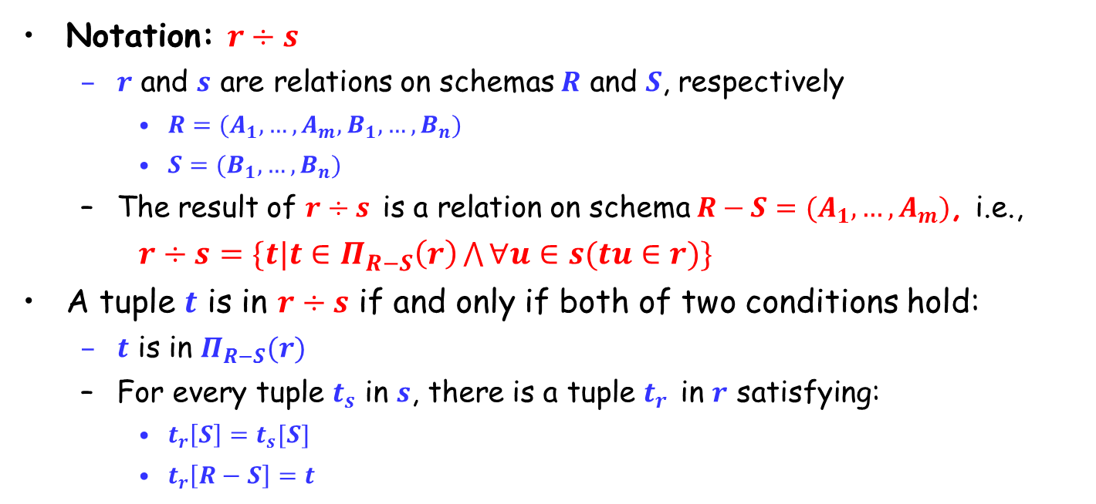
Division Operation
Notation: $r÷s$
$r$ and $s$ are relations on schemas $R$ and $S$, respectively
$R=(A_{1},…,A_{m},B_{1},…,B_{n})$
$S=(B_{1},…,B_{n})$
The result of $r÷s$ is a relation on schema $R−S=(A_{1},…,A_{m})$, i.e.,
$r÷s=\{t|t∈Π_{R−S}\left(r\right)\bigwedge{∀u∈s(tu∈r)}\}$
A tuple $t$ is in $r÷s$ if and only if both of two conditions hold:
$t$ is in $Π_{R−S}(r)$
For every tuple $t_{s}$ in $s$, there is a tuple $t_{r}$ in $r$ satisfying:
$t_{r}\left[S\right]=t_{s}[S]$
$t_{r}\left[R−S\right]=t$

Slide 60
Division Operation – Example
Relations r, s :
A
B
B
r ÷ s :
A
α
α
α
β
γ
δ
δ
δ
∈
∈
β
1
2
3
1
1
1
3
4
6
1
2
1
2
α
β
s
r

Slide 61
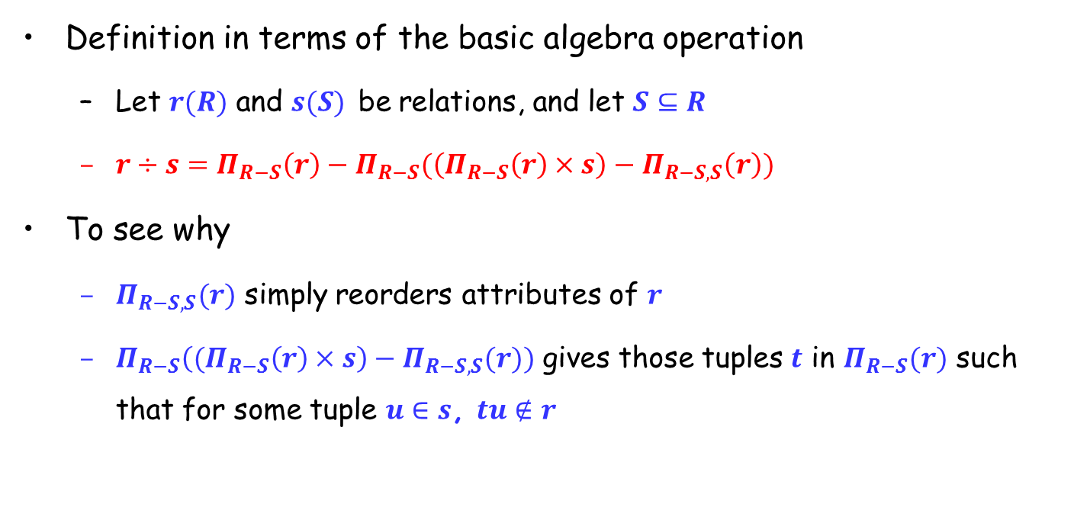
Division Operation (Cont.)
Definition in terms of the basic algebra operation
Let $r(R)$ and $s(S)$ be relations, and let $S⊆R$
$r÷s=Π_{R−S}\left(r\right)−Π_{R−S}(\left(Π_{R−S}\left(r\right)×s\right)−Π_{R−S,S}\left(r\right))$
To see why
$Π_{R−S,S}(r)$ simply reorders attributes of $r$
$Π_{R−S}\left((Π_{R−S}\left(r\right)×s\right)−Π_{R−S,S}(r))$ gives those tuples $t$ in $Π_{R−S}(r)$ such that for some tuple $u∈s$, $tu∉r$

Slide 62
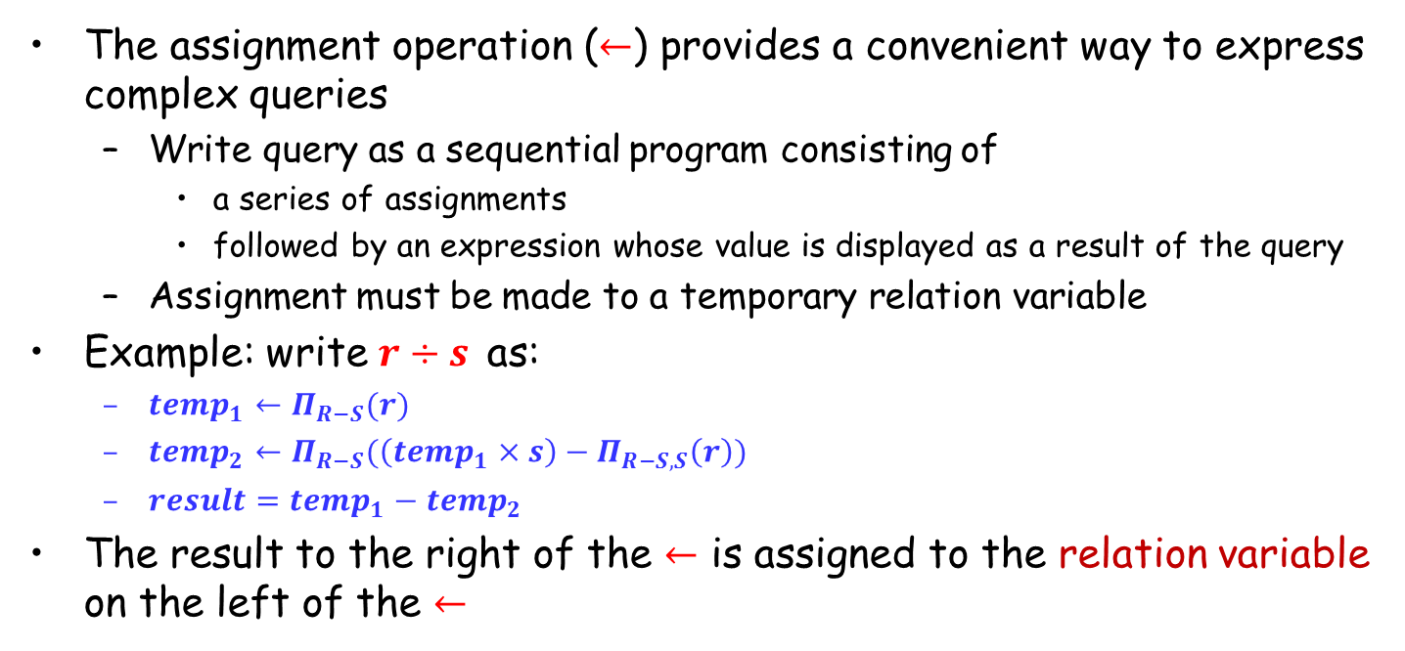
Assignment Operation
The assignment operation ($←$) provides a convenient way to express complex queries
Write query as a sequential program consisting of
a series of assignments
followed by an expression whose value is displayed as a result of the query
Assignment must be made to a temporary relation variable
Example: write $r÷s$ as:
${temp}_{1}←Π_{R−S}(r)$
${temp}_{2}←Π_{R−S}(\left({temp}_{1}×s\right)−Π_{R−S,S}\left(r\right))$
$result={temp}_{1}−{temp}_{2}$
The result to the right of the $←$ is assigned to the relation variable on the left of the $←$

Slide 63
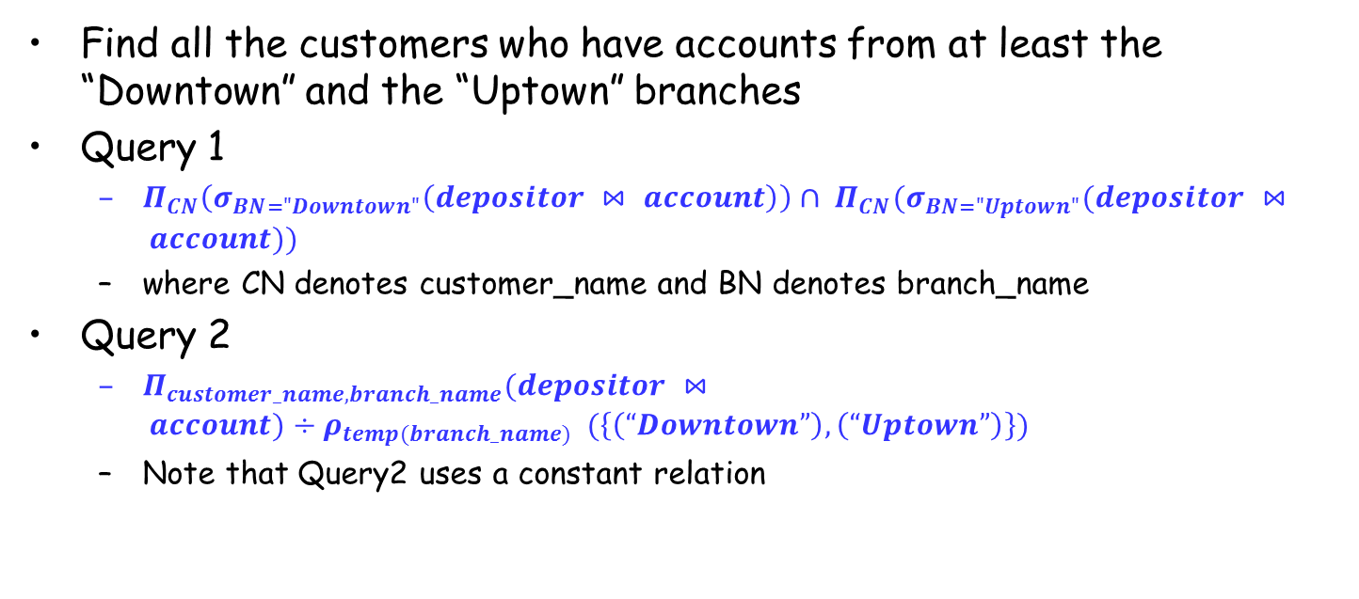
Example Queries (6)
Find all the customers who have accounts from at least the “Downtown” and the “Uptown” branches
Query 1
$Π_{CN}\left(σ_{BN="Downtown"}\left(depositor ⋈ account\right)\right)∩ Π_{CN}(σ_{BN="Uptown"}(depositor ⋈ account))$
where CN denotes customer_name and BN denotes branch_name
Query 2
$Π_{customer_name,branch_name}(depositor ⋈ account)÷ρ_{temp(branch_name)} (\left\{\left(“Downtown”\right), \left(“Uptown”\right)\right\})$
Note that Query2 uses a constant relation

Slide 64
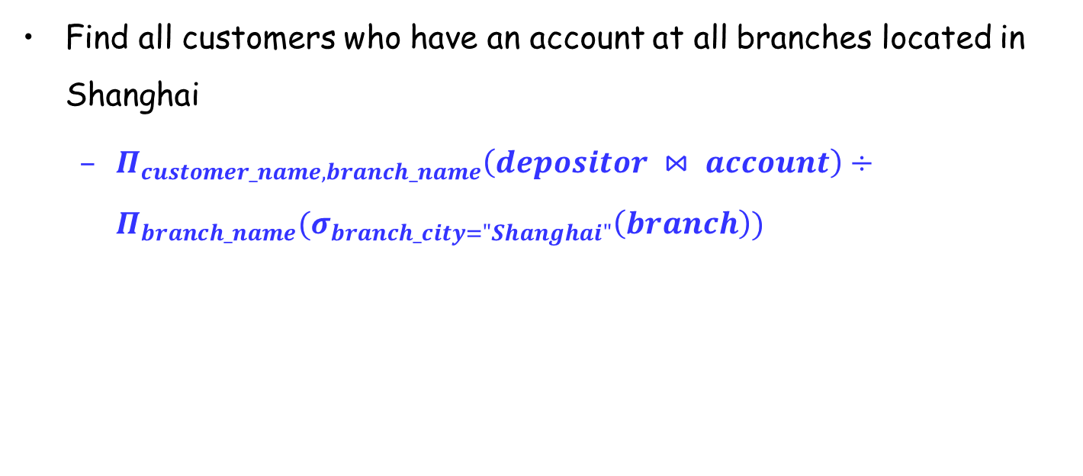
Example Queries (7)
Find all customers who have an account at all branches located in Shanghai
$Π_{customer_name,branch_name}\left(depositor ⋈ account\right)÷Π_{branch_name}(σ_{branch_city="Shanghai"}\left(branch\right))$

Slide 65
Extended Relational Algebra Operations
Generalized Projection（广义投影）
Aggregate Functions （聚合函数）

Slide 66
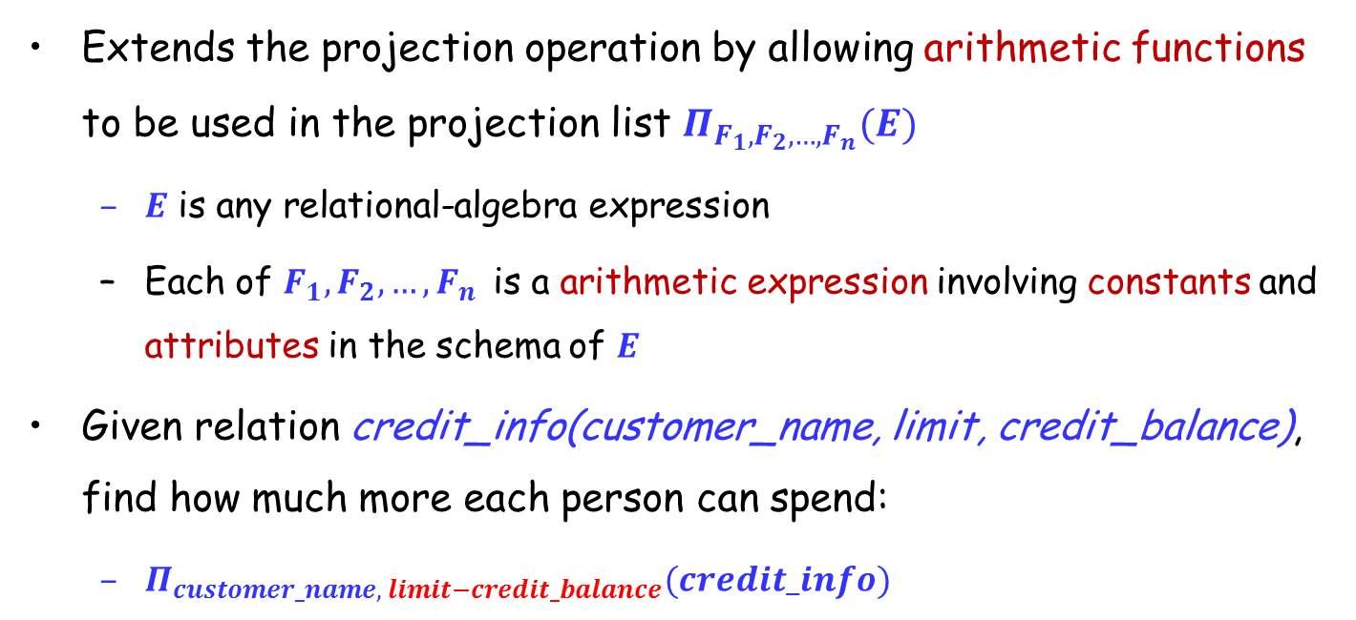
Generalized Projection
Extends the projection operation by allowing arithmetic functions to be used in the projection list $Π_{F_{1},F_{2},…,F_{n}}(E)$
$E$ is any relational-algebra expression
Each of $F_{1},F_{2},…,F_{n}$ is a arithmetic expression involving constants and attributes in the schema of $E$
Given relation credit_info(customer_name, limit, credit_balance), find how much more each person can spend:
$Π_{customer_name, limit−credit_balance}(credit_info)$

Slide 67
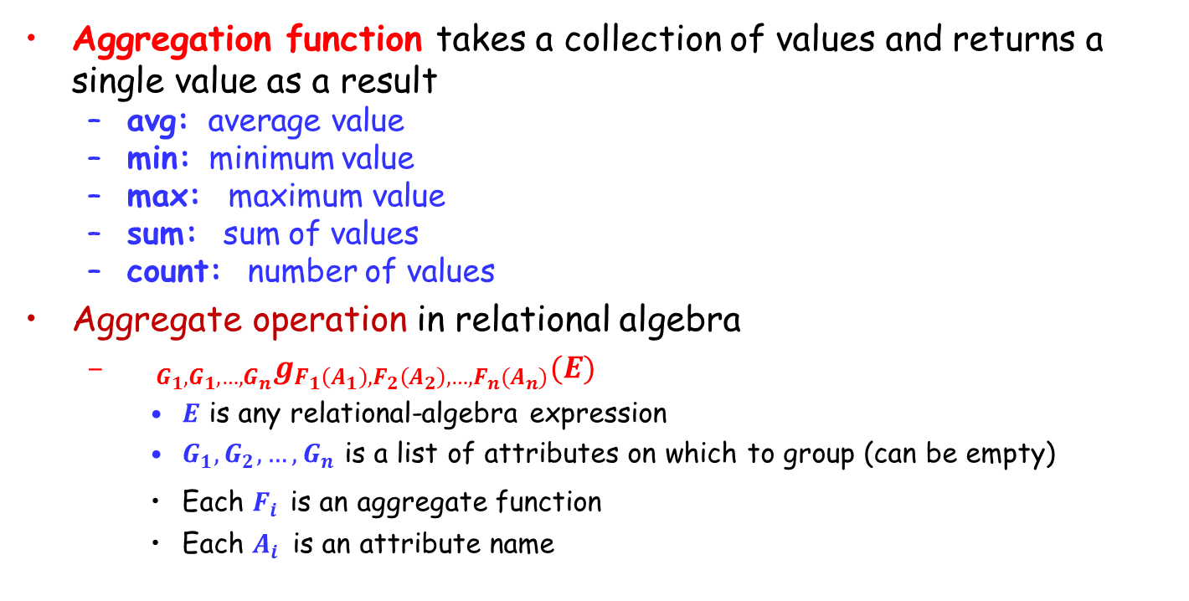
Aggregate Functions and Operations
Aggregation function takes a collection of values and returns a single value as a result
avg: average value
min: minimum value
max: maximum value
sum: sum of values
count: number of values
Aggregate operation in relational algebra
${{}_{G_{1},G_{1},…,G_{n}}g}_{F_{1}\left(A_{1}\right),F_{2}\left(A_{2}\right),…,F_{n}(A_{n})}(E)$
$E$ is any relational-algebra expression
$G_{1},G_{2},…,G_{n}$ is a list of attributes on which to group (can be empty)
Each $F_{i}$ is an aggregate function
Each $A_{i}$ is an attribute name

Slide 68
Aggregate Operation – Example
Relation r :
A
B
C
g _{sum(c)} (r) :
Sum(C)
α
α
β
β
α
β
β
β
7
7
3
10
27
Relation account grouped by branch_name:
_{branch_name} g _{sum(balance)} (account)
branch_name
account_number
balance
Perryridge
Perryridge
Brighton
Brighton
Redwood
A-102
A-201
A-217
A-215
A-222
400
900
750
750
700
branch_name
balance
Perryridge
Brighton
Redwood
1300
1500
700

Slide 69
Aggregate Functions (Cont.)
Result of aggregation does not have a name
Can use rename operation to give it a name
For convenience, we permit renaming as part of aggregate operation
_{branch_name} g _{sum(balance) as sum_balance} (account)

Slide 70
Null Values
It is possible for tuples to have a null value for some of their attributes
null signifies an unknown value or that a value does not exist
The result of any arithmetic expression involving null is null
Aggregate functions simply ignore null values
Is an arbitrary decision? Could have returned null as result instead?
We follow the semantics of SQL in its handling of null values
For duplicate elimination and grouping, null is treated like any other value, and two nulls are assumed to be the same
Alternative: assume each null is different from each other
Both are arbitrary decisions, so we simply follow SQL

Slide 71
Null Values
Three-valued logic (三值逻辑) using the truth value unknown
OR: (unknown or true) = true, (unknown or false) = unknown (unknown or unknown) = unknown
AND: (true and unknown) = unknown, (false and unknown) = false, (unknown and unknown) = unknown
NOT: (not unknown) = unknown
In SQL “P is unknown” evaluates to true if predicate P evaluates to unknown
Result of select predicate is treated as false if it evaluates to unknown

Slide 72
Modification of the Database
The content of the database may be modified using the following operations:
Deletion
Insertion
Updating
All these operations are expressed using the assignment operation

Slide 73
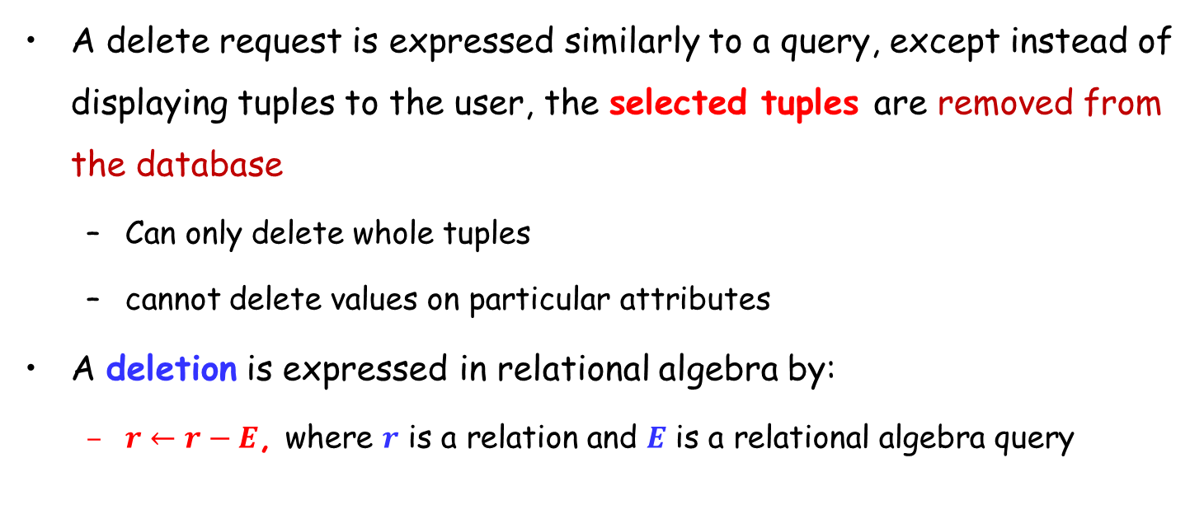
Deletion
A delete request is expressed similarly to a query, except instead of displaying tuples to the user, the selected tuples are removed from the database
Can only delete whole tuples
cannot delete values on particular attributes
A deletion is expressed in relational algebra by:
$r←r−E$, where $r$ is a relation and $E$ is a relational algebra query

Slide 74
Deletion Examples
Delete all account records in the Perryridge branch.
Delete all loan records with amount in the range of 0 to 50
Delete all accounts at branches located in Shanghai
account ← account – σ _{branch_name = “Perryridge”} (account)
loan ← loan – σ _{amount ≥ 0 and amount ≤ 50} (loan)
r₁ ← σ _{branch_city = “Shanghai”} (account branch)
r₂ ← ∏ account_number, branch_name, balance ( r₁ )
r₃ ← ∏ _{customer_name, account_number} (r₂ depositor)
account ← account – r₂
depositor ← depositor – r₃

Slide 75
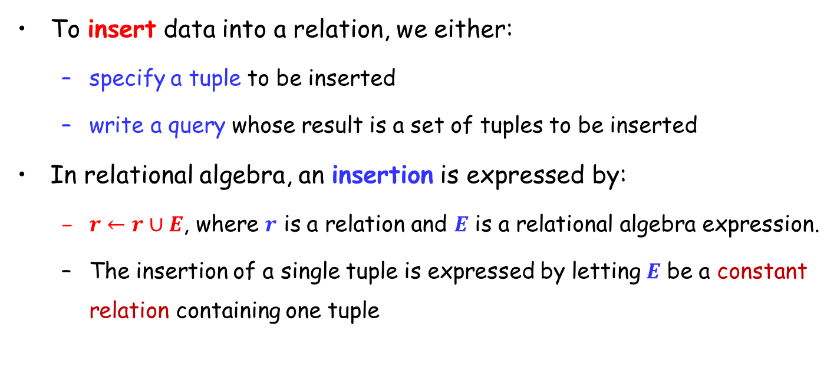
Insertion
To insert data into a relation, we either:
specify a tuple to be inserted
write a query whose result is a set of tuples to be inserted
In relational algebra, an insertion is expressed by:
$r←r∪E$, where $r$ is a relation and $E$ is a relational algebra expression.
The insertion of a single tuple is expressed by letting $E$ be a constant relation containing one tuple

Slide 76
Insertion Examples
Insert information in the database specifying that Smith has $1200 in account A_973 at the Perryridge branch.
Provide as a gift for all loan customers in the Perryridge branch, a $200 savings account. Let the loan number serve as the account number for the new savings account.
account ← account ∪ {(A_973, “Perryridge”, 1200)}
depositor ← depositor ∪ {(“Smith”, A_973)}
r₁ ← (σ_{branch_name = “Perryridge”} (borrower loan))
account ← account ∪ ∏_{loan_number, branch_name, 200} (r₁)
depositor ← depositor ∪ ∏_{customer_name, loan_number}(r₁)

Slide 77
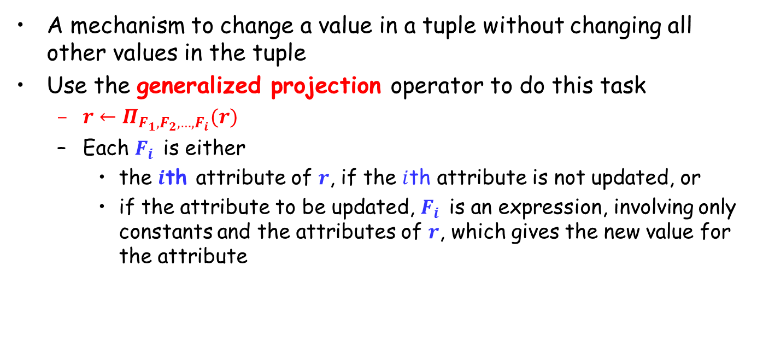
Updating
A mechanism to change a value in a tuple without changing all other values in the tuple
Use the generalized projection operator to do this task
$r←Π_{F_{1},F_{2},…,F_{i}}(r)$
Each $F_{i}$ is either
the $i$th attribute of $r$, if the $i$th attribute is not updated, or
if the attribute to be updated, $F_{i}$ is an expression, involving only constants and the attributes of $r$, which gives the new value for the attribute

Slide 78
Update Examples
Make interest payments by increasing all balances by 5 percent.
where AN, BN and BAL stand for account_number, branch_name and balance, respectively
Pay all accounts with balances over $10,000 6 percent interest and pay all others 5 percent
account ← ∏ _{AN, BN, BAL * 1.05} (account)
account ← ∏ _{AN, BN, BAL * 1.06} (σ _{BAL > 10000} (account)) ∪ ∏_{AN, BN, BAL * 1.05} (σ_{BAL ≤ 10000} (account))

Slide 79
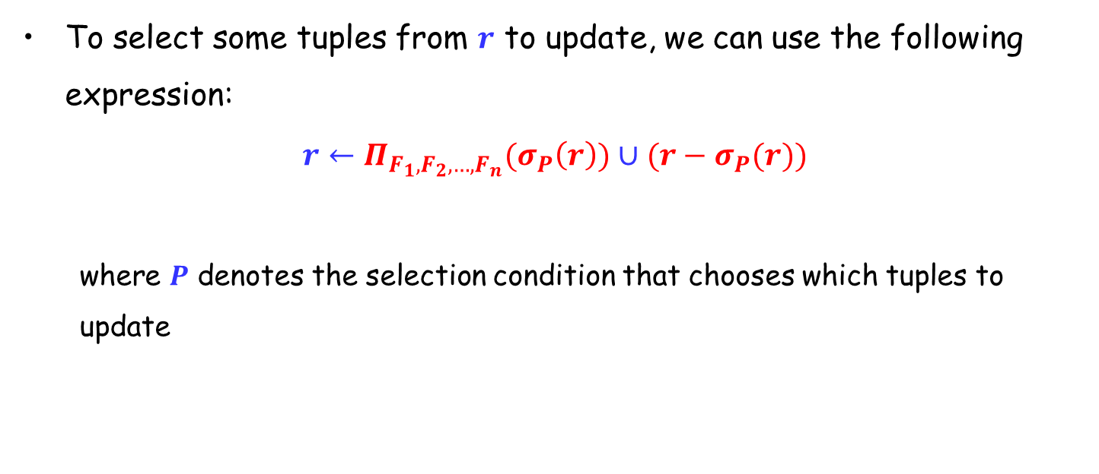
Updating
To select some tuples from $r$ to update, we can use the following expression:
$$r←Π_{F_{1},F_{2},…,F_{n}}(σ_{P}\left(r\right))∪(r−σ_{P}(r))$$
where $P$ denotes the selection condition that chooses which tuples to update

Slide 80
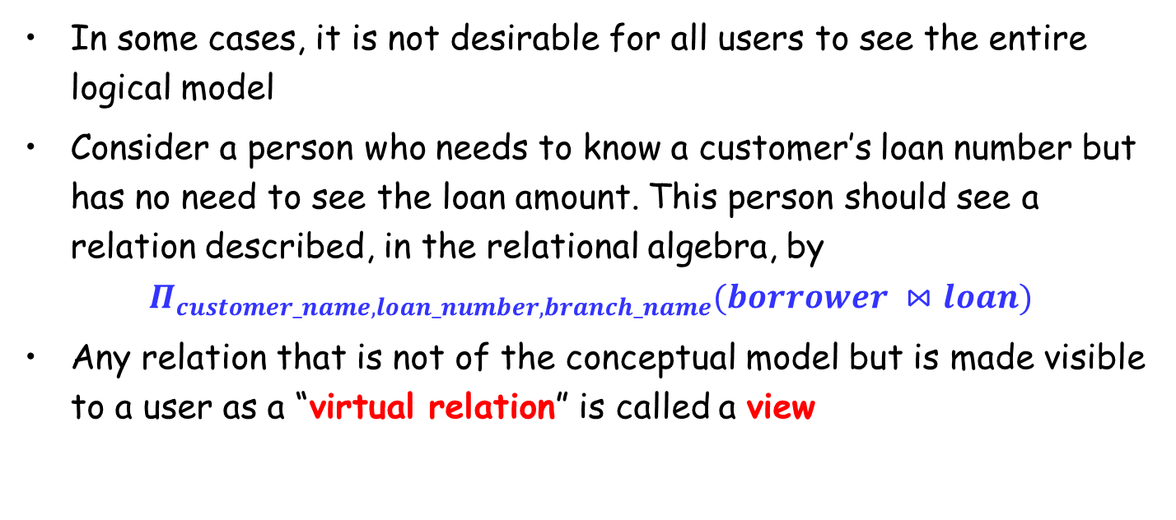
Views（视图）
In some cases, it is not desirable for all users to see the entire logical model
Consider a person who needs to know a customer’s loan number but has no need to see the loan amount. This person should see a relation described, in the relational algebra, by
$$Π_{customer_name, loan_number, branch_name}(borrower ⋈loan)$$
Any relation that is not of the conceptual model but is made visible to a user as a “virtual relation” is called a view

Slide 81
View Definition
A view is defined using the create view statement which has the form
create view v as < query expression >
Once a view is defined, the view name can be used to refer to the virtual relation that the view generates
View definition is not the same as creating a new relation by evaluating the query expression
Rather, a view definition causes the saving of an expression
the expression is substituted into queries using the view

Slide 82
View Examples
Consider the view (named all_customer) consisting of branches and their customers
We can find all customers of the Perryridge branch by writing:
create view all_customer as
∏_{branch_name, customer_name} (depositor account)
∪ ∏_{branch_name, customer_name} (borrower loan)
∏_{customer_name} (σ_{branch_name = “Perryridge”} (all_customer))

Slide 83

Updates Through View
Must be translated to modifications of the actual relations
Consider the person who needs to see all loan data in the loan relation except amount. The view given to the person, branch_loan, is defined as:
create view branch_loan as $Π_{branch_name,loan_number}(loan)$
Since we allow a view name to appear wherever a relation name is allowed, the person may write:
$$branch_loan←branch_loan ∪\{(\text{"}\text{Perryridge}\text{"}, L_37)\}$$
An insertion into relation loan requires a value for amount. The insertion can be handled by either.
rejecting the insertion
inserting a tuple (L_37, “Perryridge”, null)

Slide 84

Updates Through Views (Cont.)
Some updates through views are impossible to translate into database relation updates
$$create view v as (σ_{branch_name="Perryridge"}(account)$$
$$v←v∪(L_99,\text{"}\text{Downtown}\text{"},23)$$
Others cannot be translated uniquely
$$all_customer←all_customer∪\{(\text{Perryridge},"John")\}$$
Have to choose loan or account, and create a new loan/account number
create view all_customer as
∏_{branch_name, customer_name} (depositor account)
∪ ∏_{branch_name, customer_name} (borrower loan)

Slide 85

Views Defined Using Other Views
One view may be used to define another view
A view relation $v_{1}$is said to depend directly (直接依赖) on a view relation $v_{2}$ if $v_{2}$ is used in the expression defining $v_{1}$
A view relation $v_{1}$ is said to depend（依赖）on view relation $v_{2}$ if either $v_{1}$ depends directly to $v_{2}$ or there is a path of dependencies from $v_{1}$ to $v_{2}$
A view relation $v$ is said to be recursive (递归) if it depends on itself

Slide 86

View Expansion
A way to define the meaning of views defined in terms of other views
Let view $v_{1}$ be defined by an expression $e_{1}$ that may itself contain uses of view relations
View expansion of an expression repeats the following replacement step:
repeat Find any view relation $v_{i}$ in $e_{1}$ Replace the view relation $v_{i}$ by the expression defining $v_{i}$ until no more view relations are present in $e_{1}$
As long as the view definitions are not recursive, this loop will terminate

Slide 87
Homework
Exercises
2.1, 2.6, 2.7, 2.8, 2.15 (选做其中3题)
Submission
Canvas上提交，上传单个PDF文件
Deadline: Sep 30, 2023

Slide 88
End of Lecture 2

